Slide 1
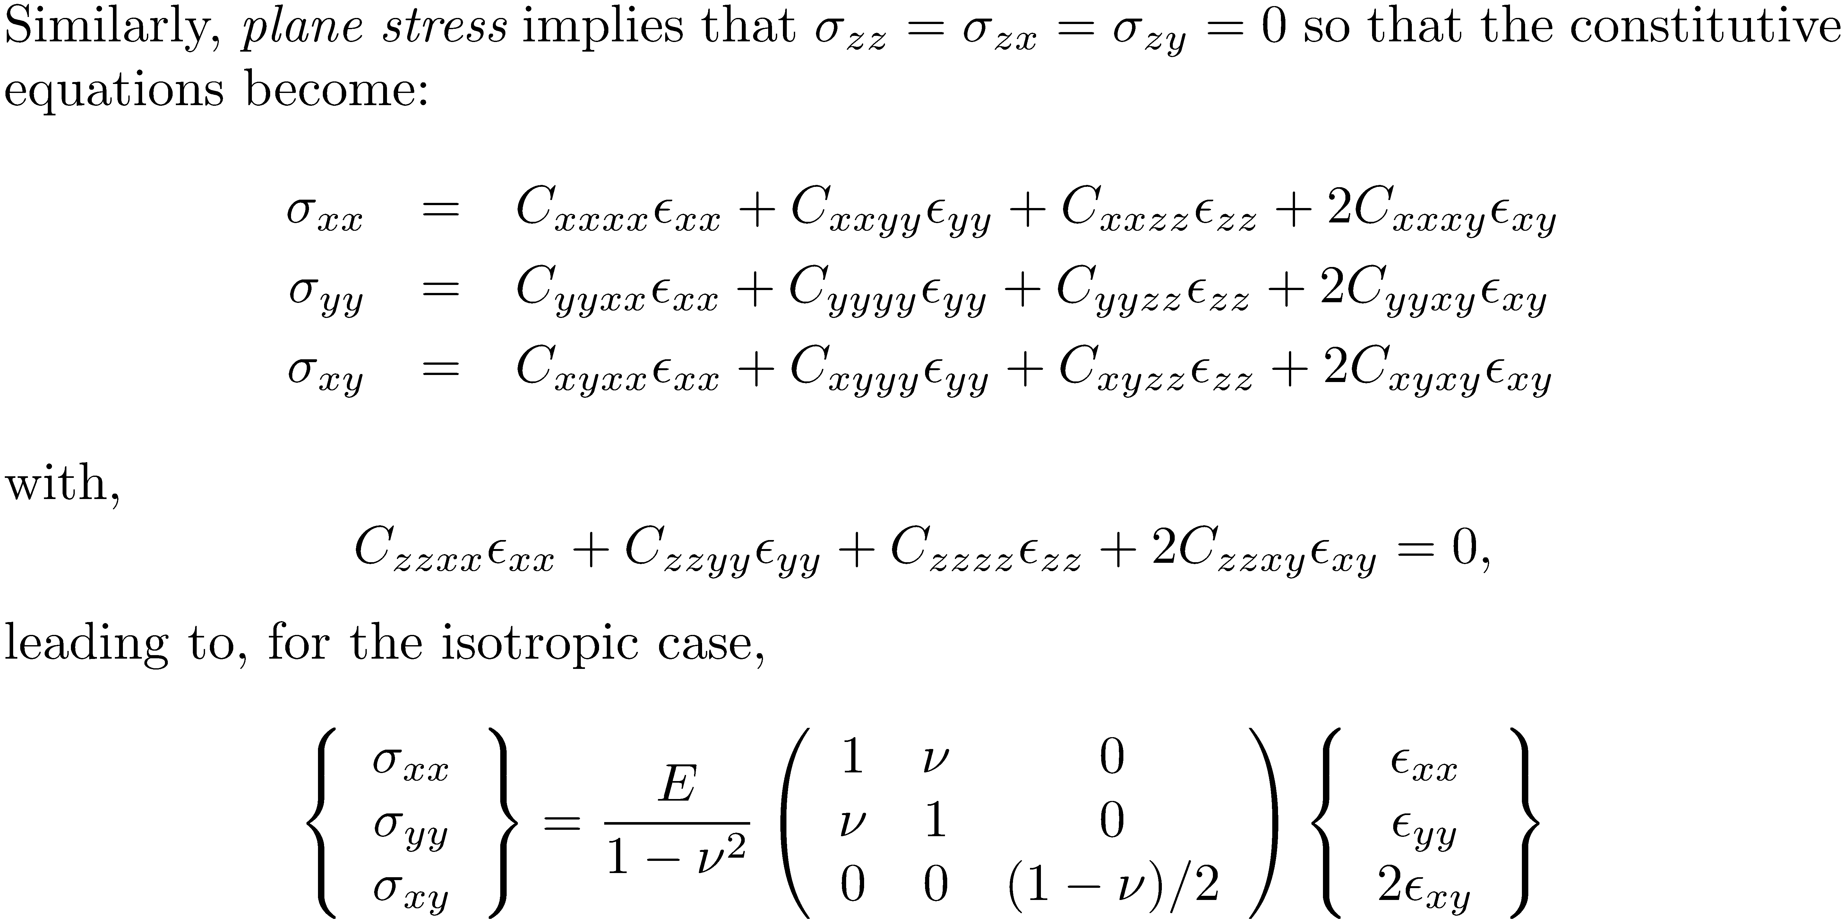

Slide 2
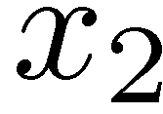
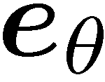
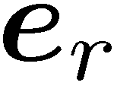



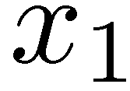
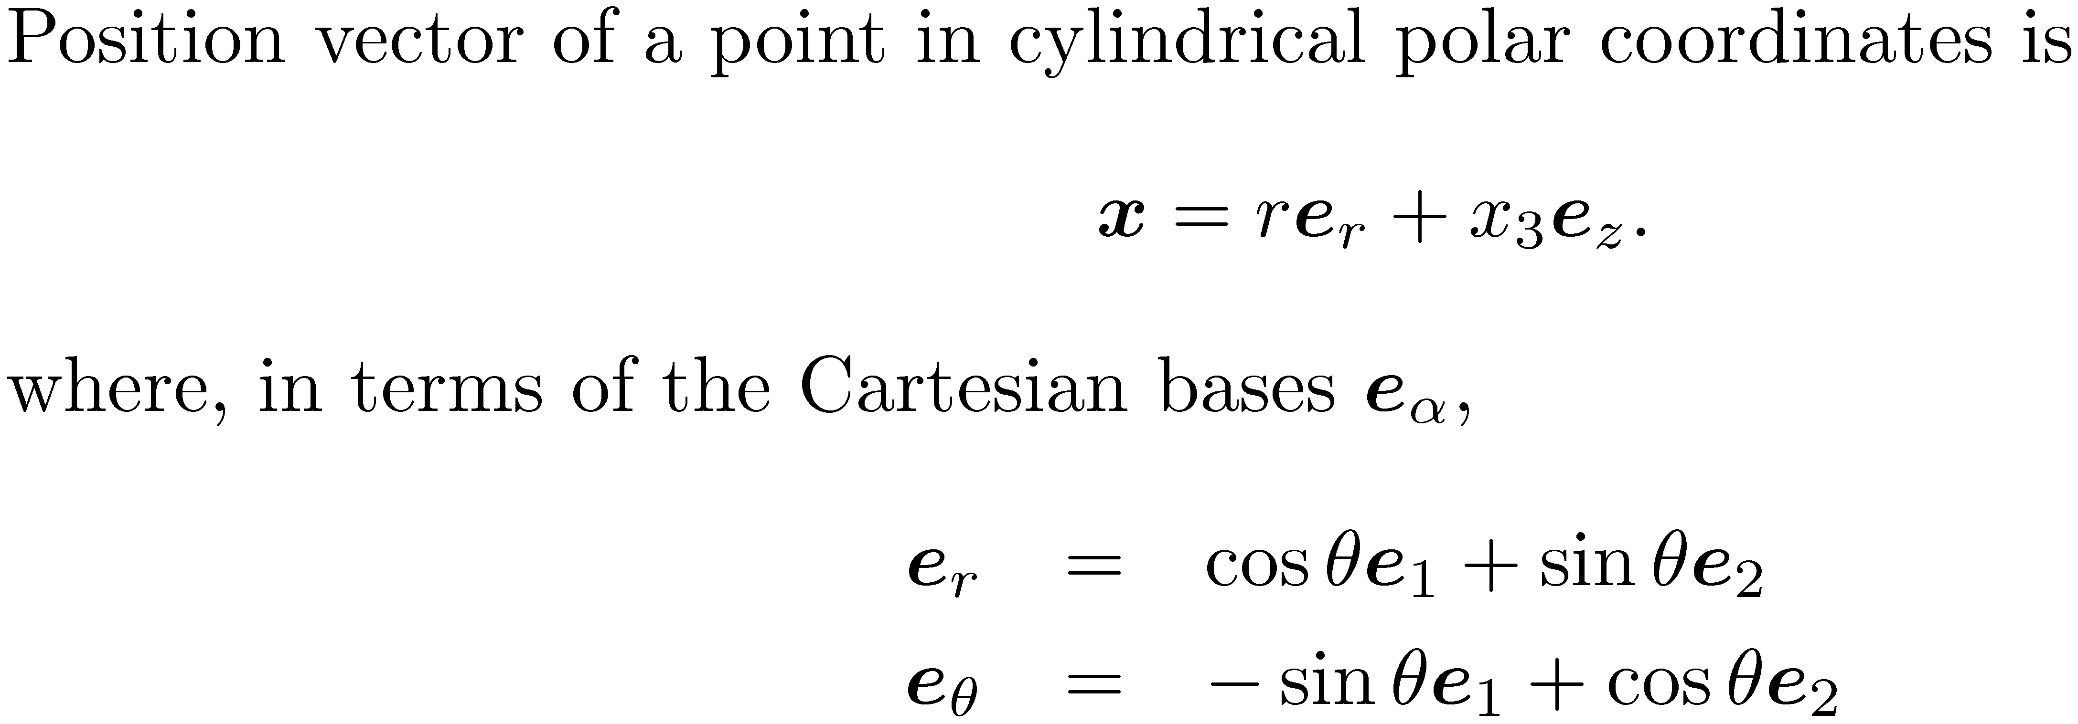

Slide 3
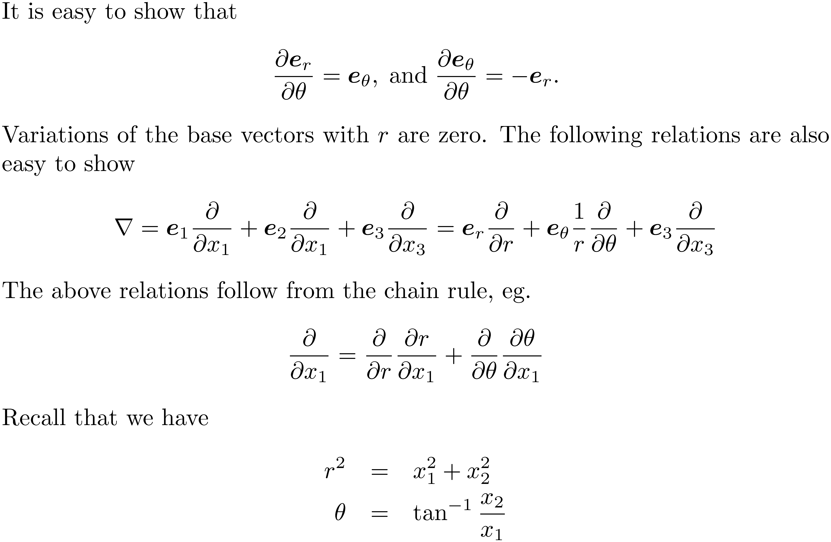

Slide 4
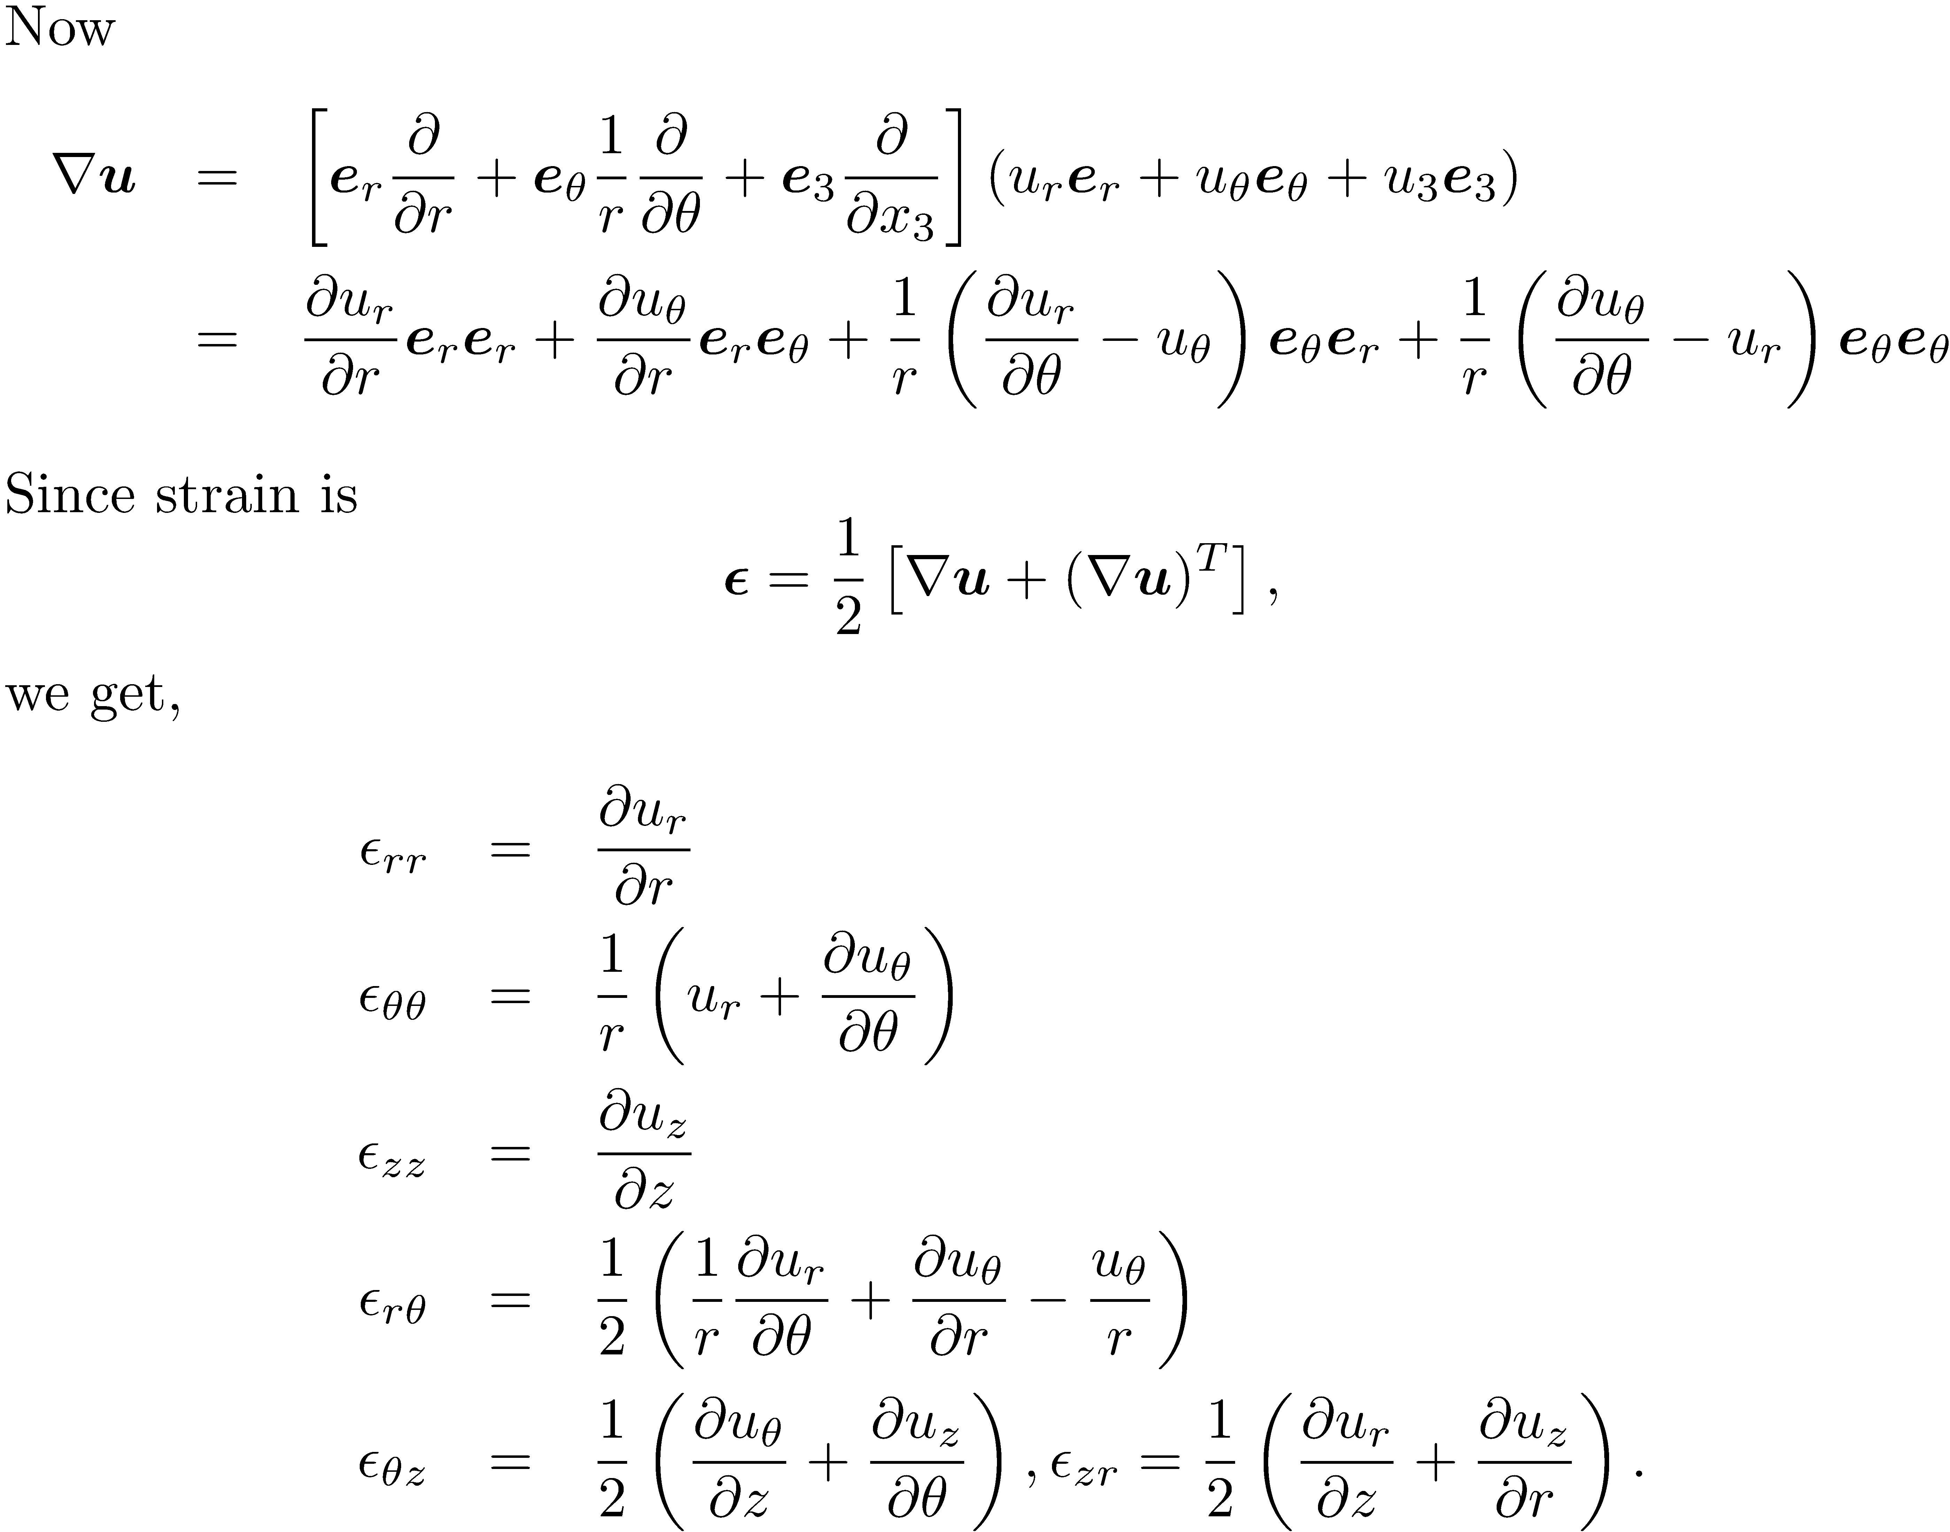

Slide 5
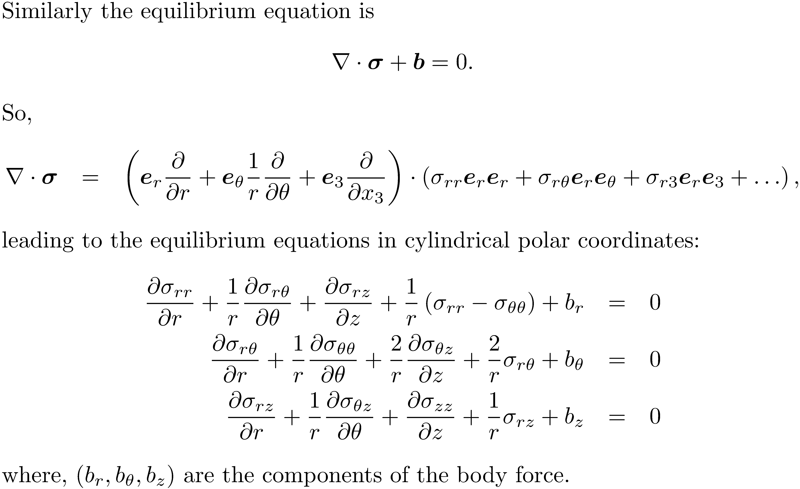

Slide 6
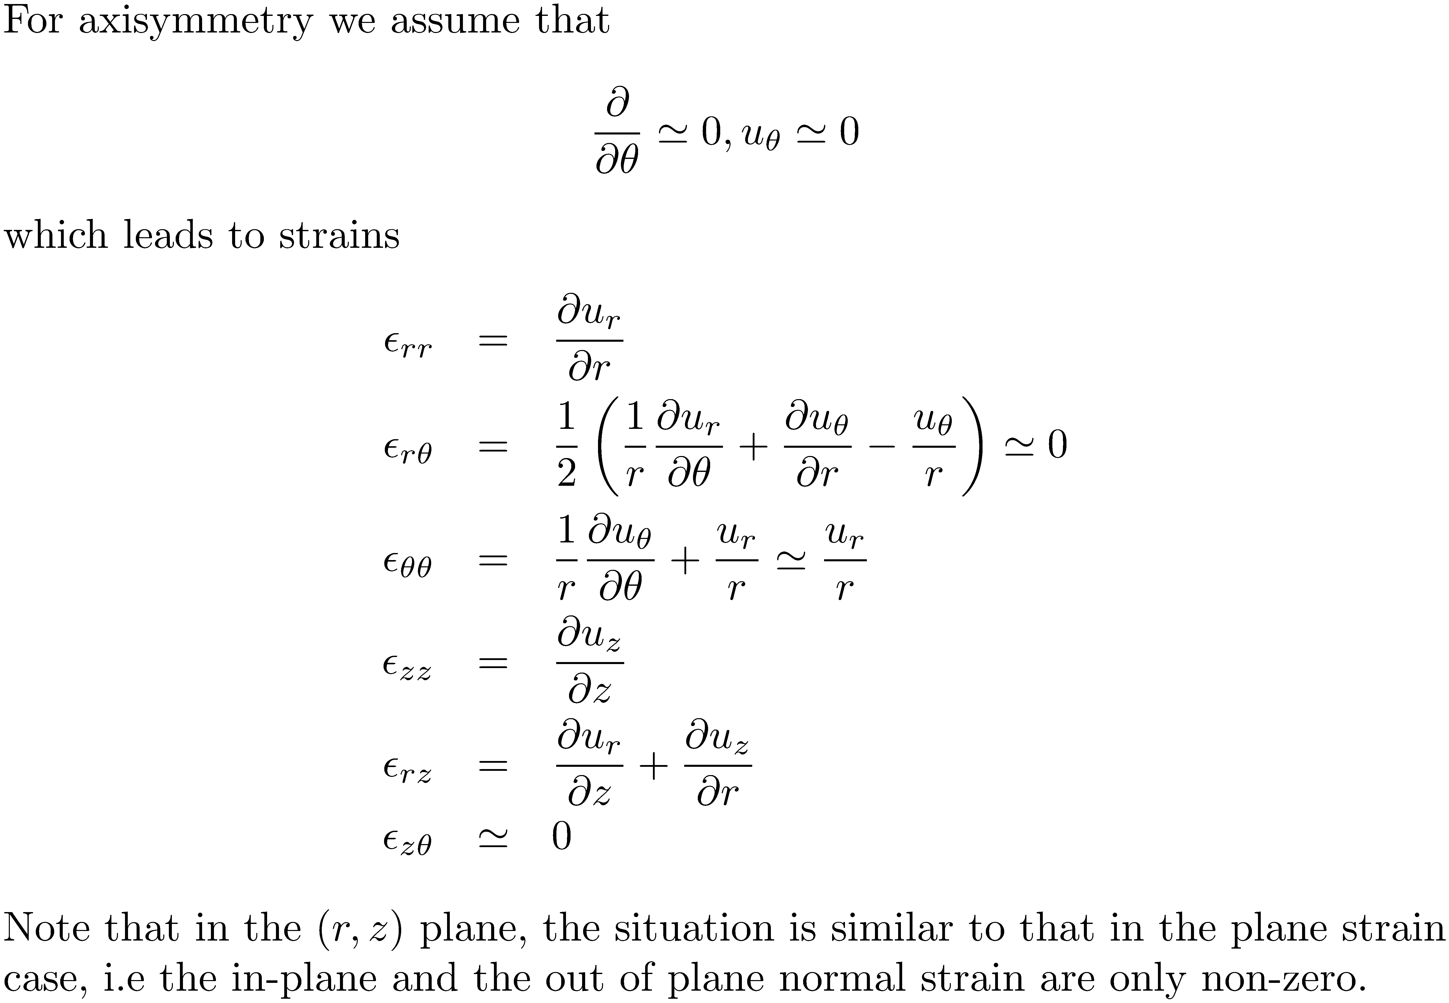

Slide 7
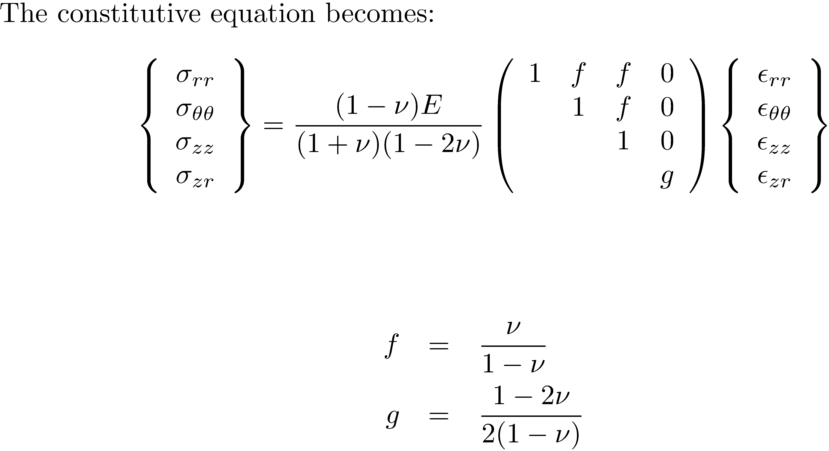

Slide 8
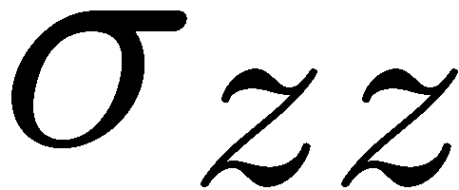

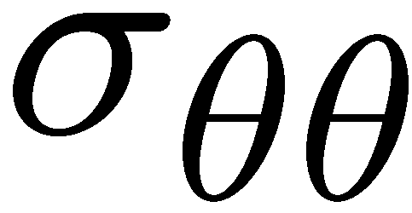
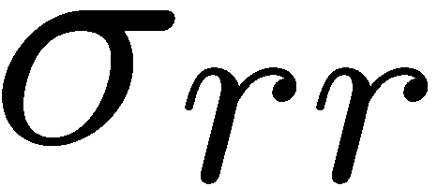
Geometry as well as loading should be axisymmetric!

Slide 9
C
L
Plane strain
Axisymmetric

Slide 10
Axisymmetric geometry, Non-axisymmetric loading

Slide 11
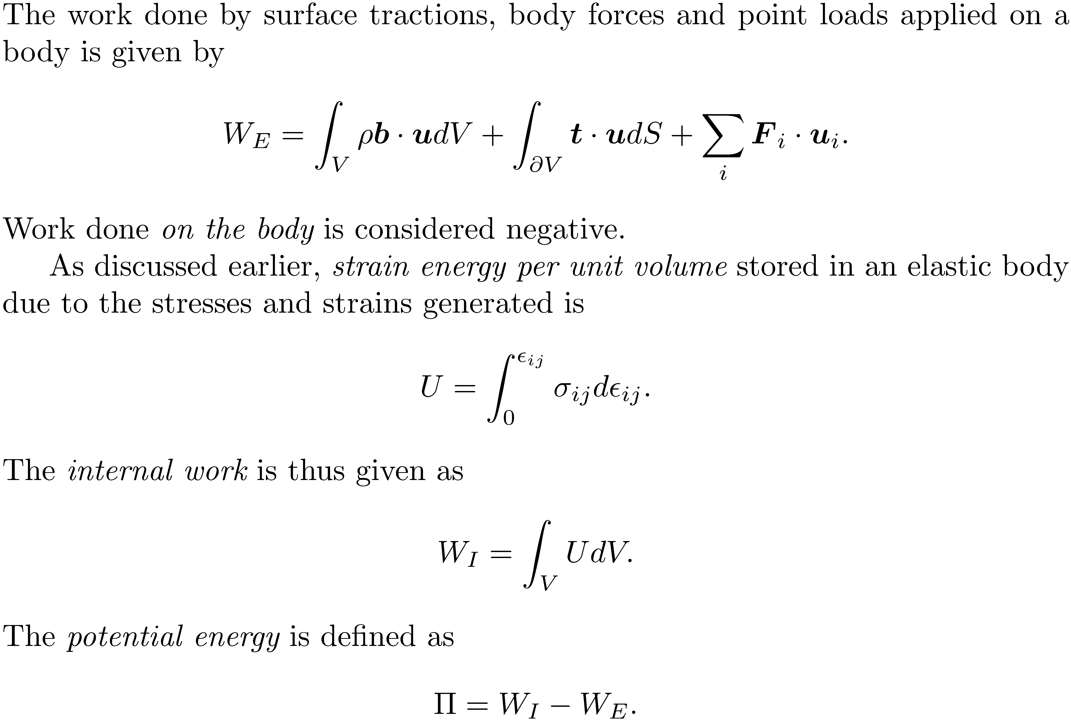
Work and strain energy

Slide 12
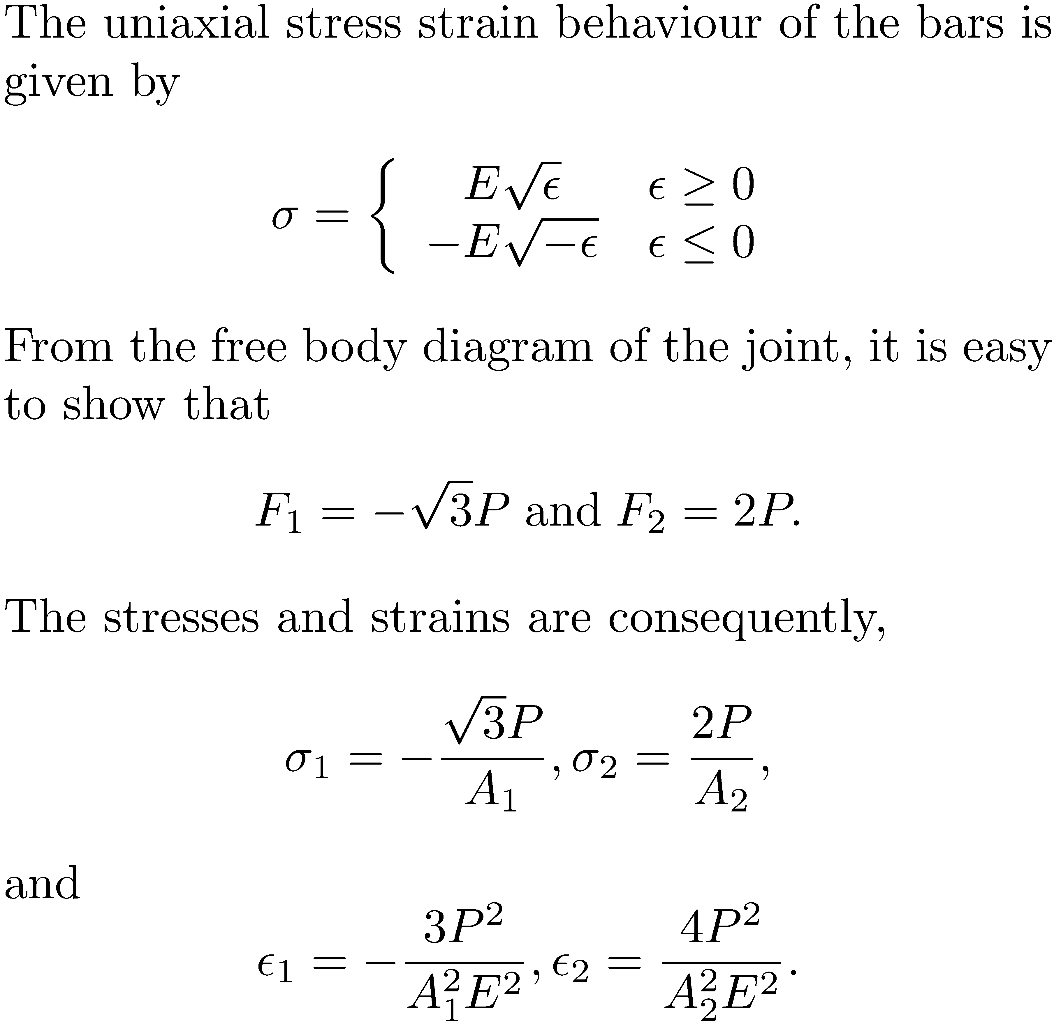
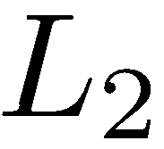
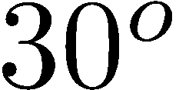
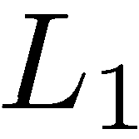
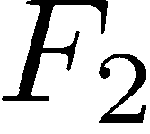
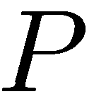
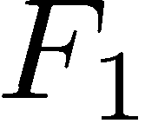

Slide 13
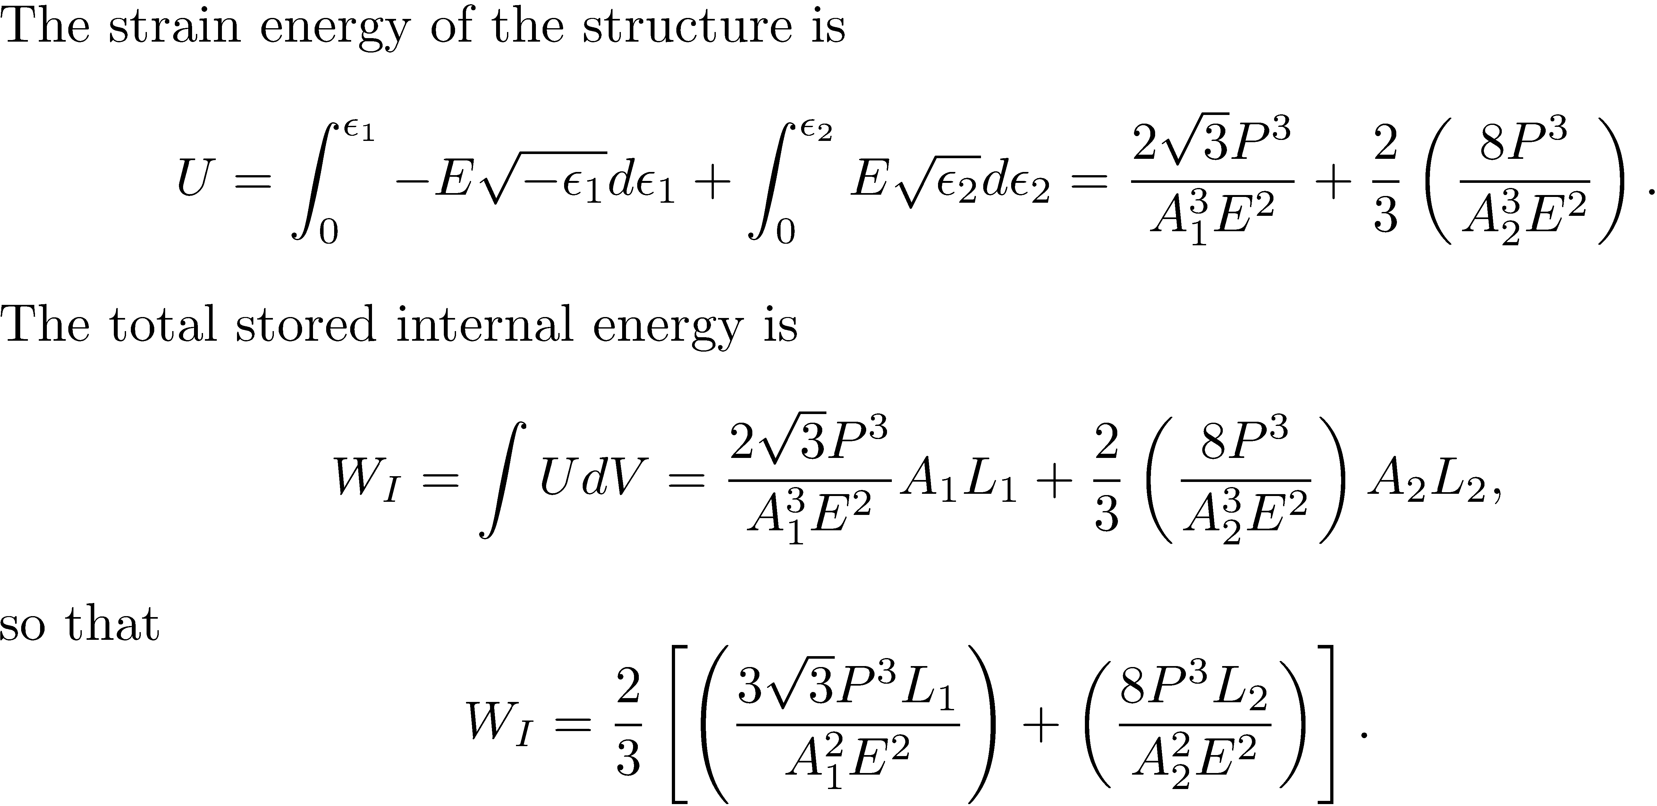

Slide 14

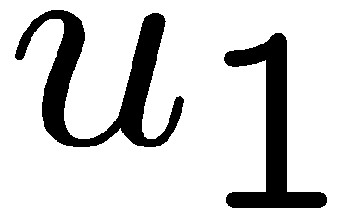
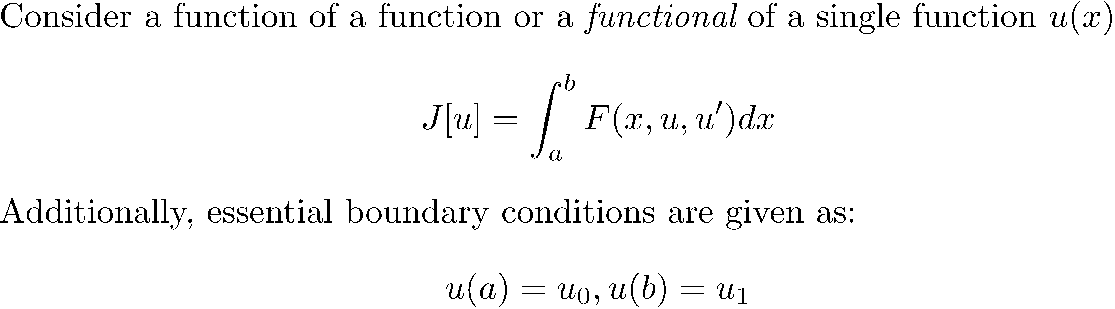
Introduction to variational methods
u(x)
b
a

Slide 15
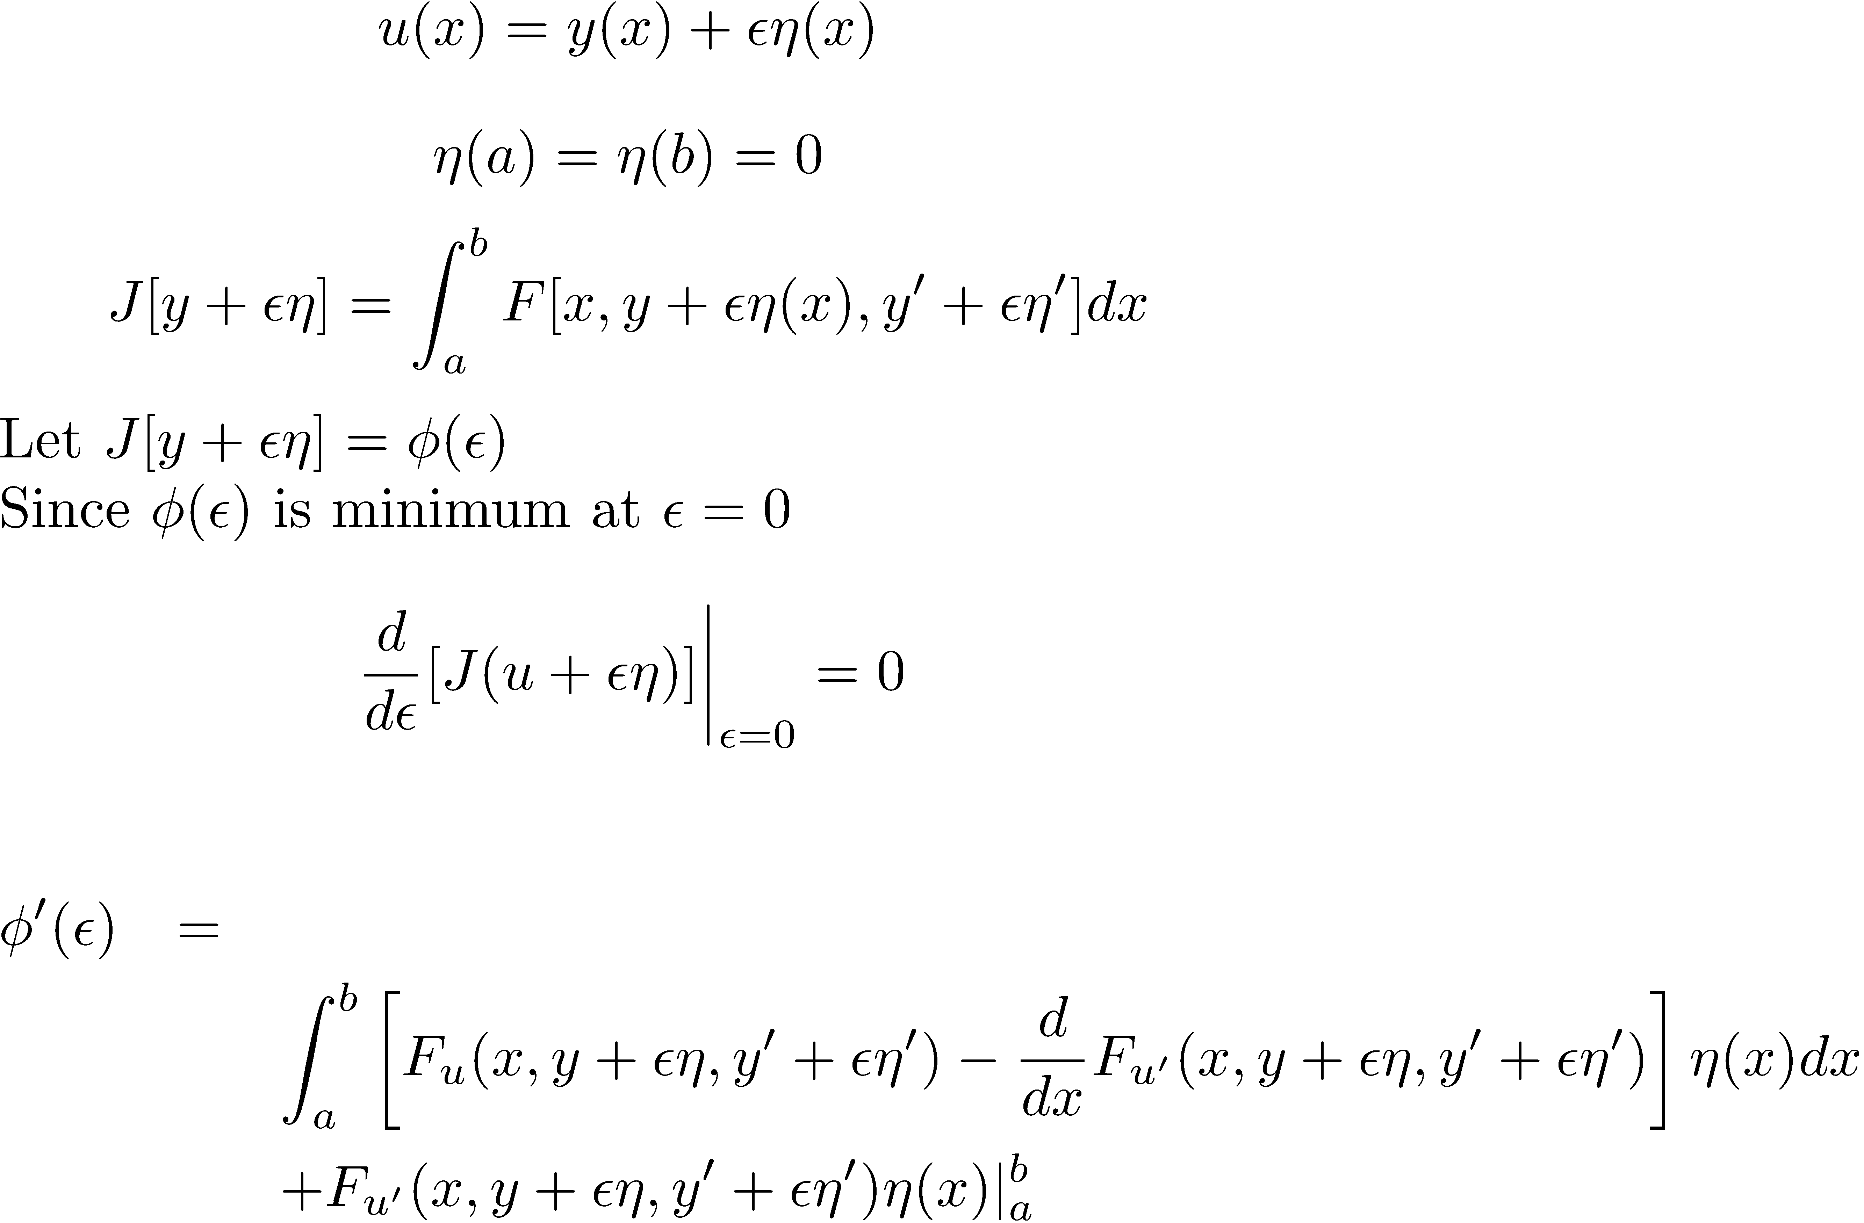
Perturbations that honour the end conditions of the essential boundary conditions are called admissible perturbations.
u(x)
u(x)
y(x)
b
a
η (x)

Slide 16
Euler equation

Slide 17
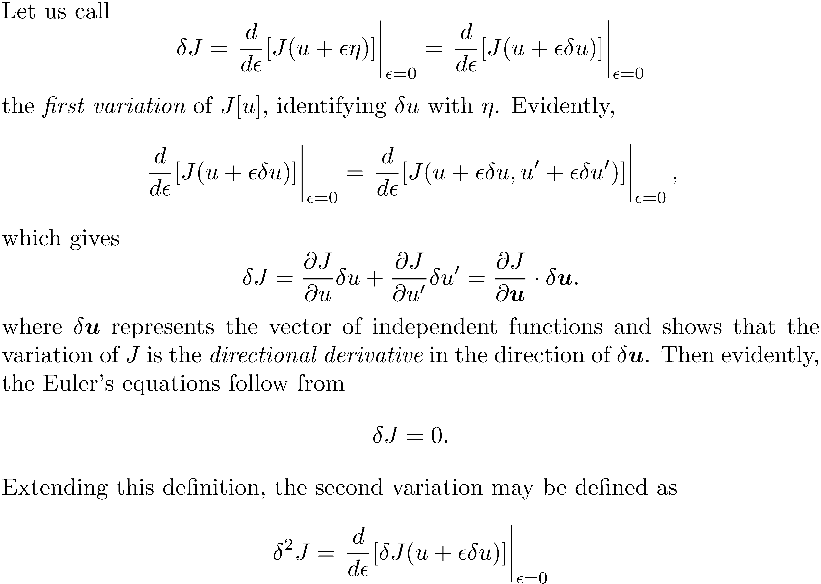

Slide 18
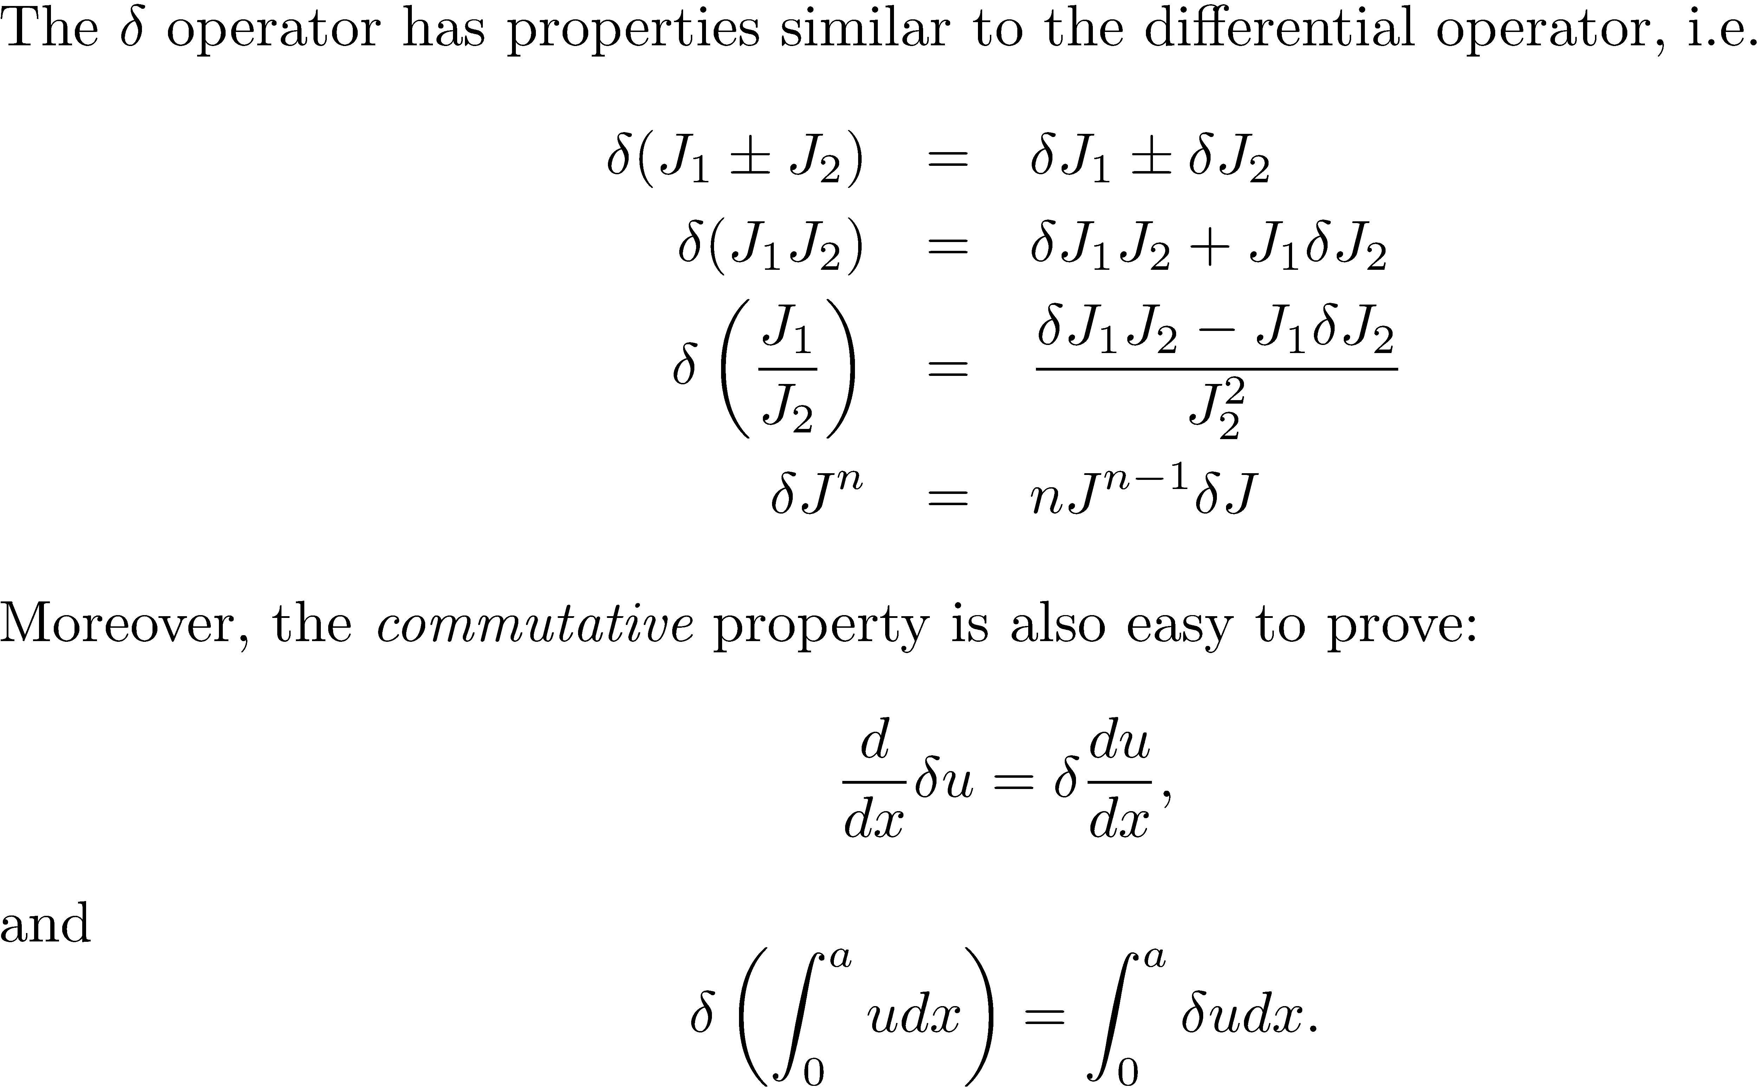

Slide 19
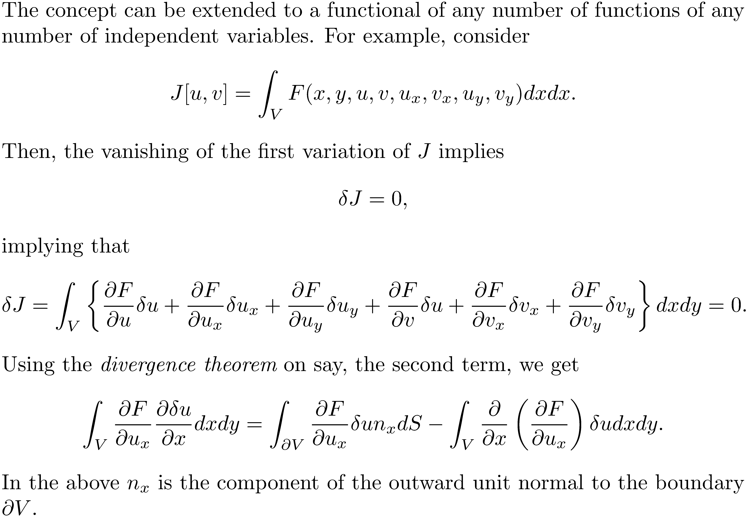

Slide 20
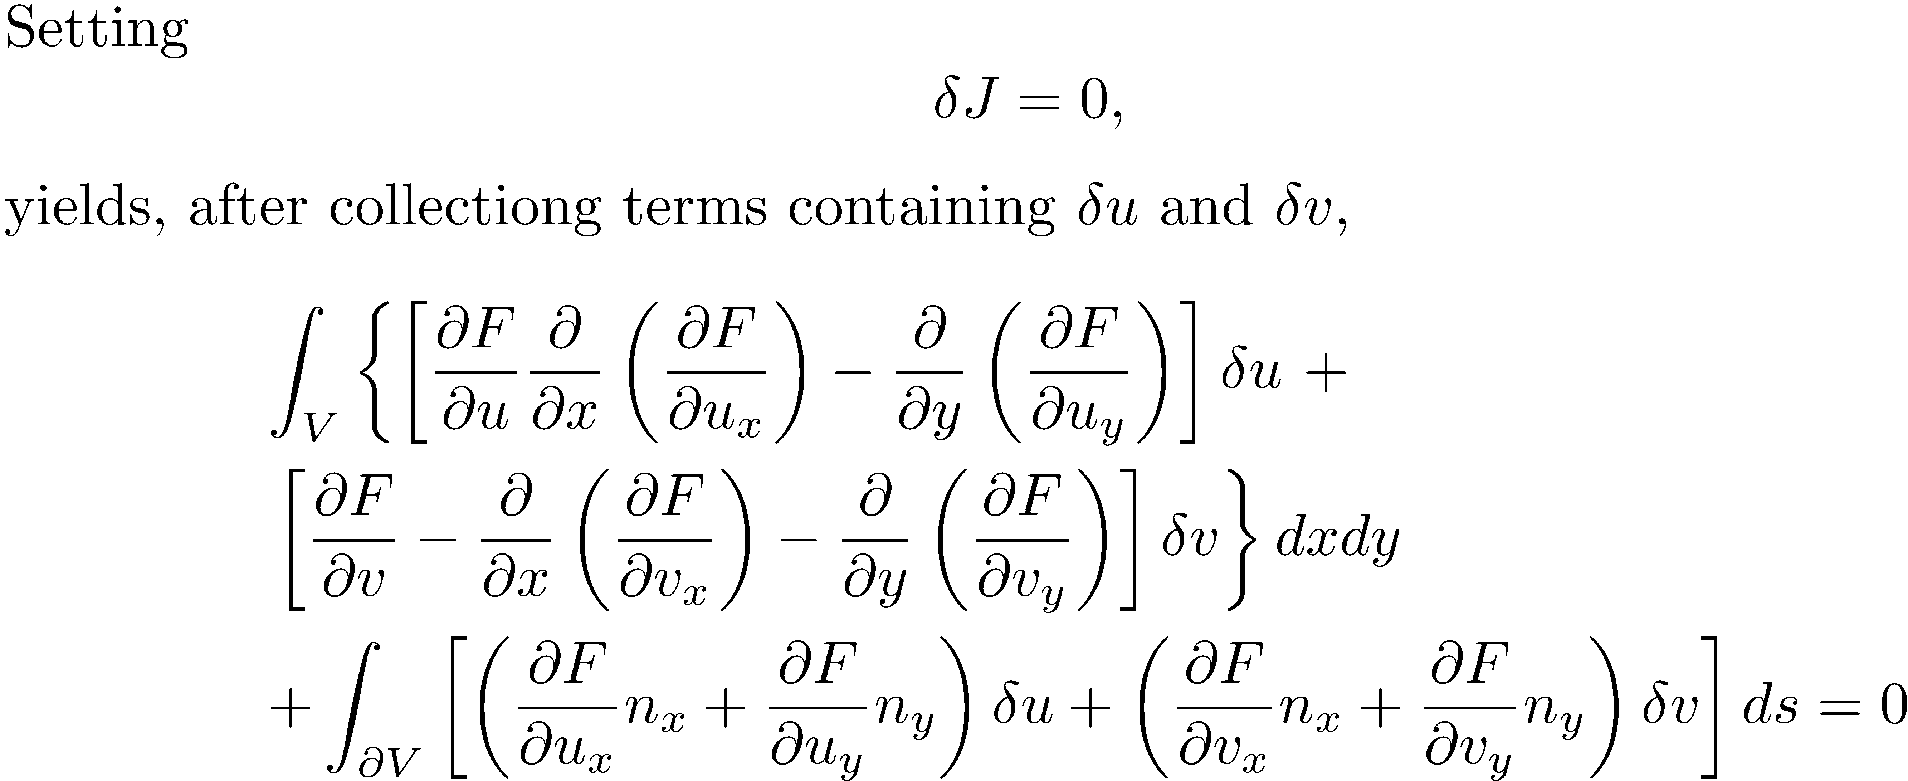

Slide 21
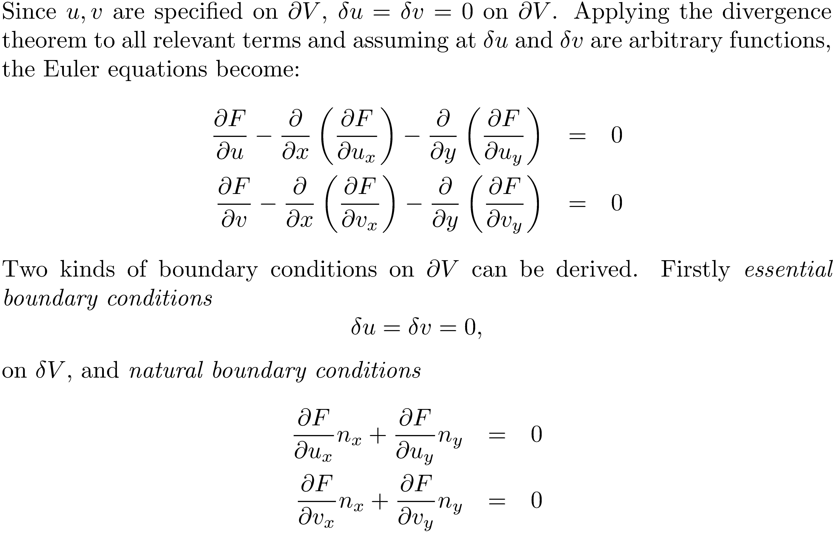

Slide 22
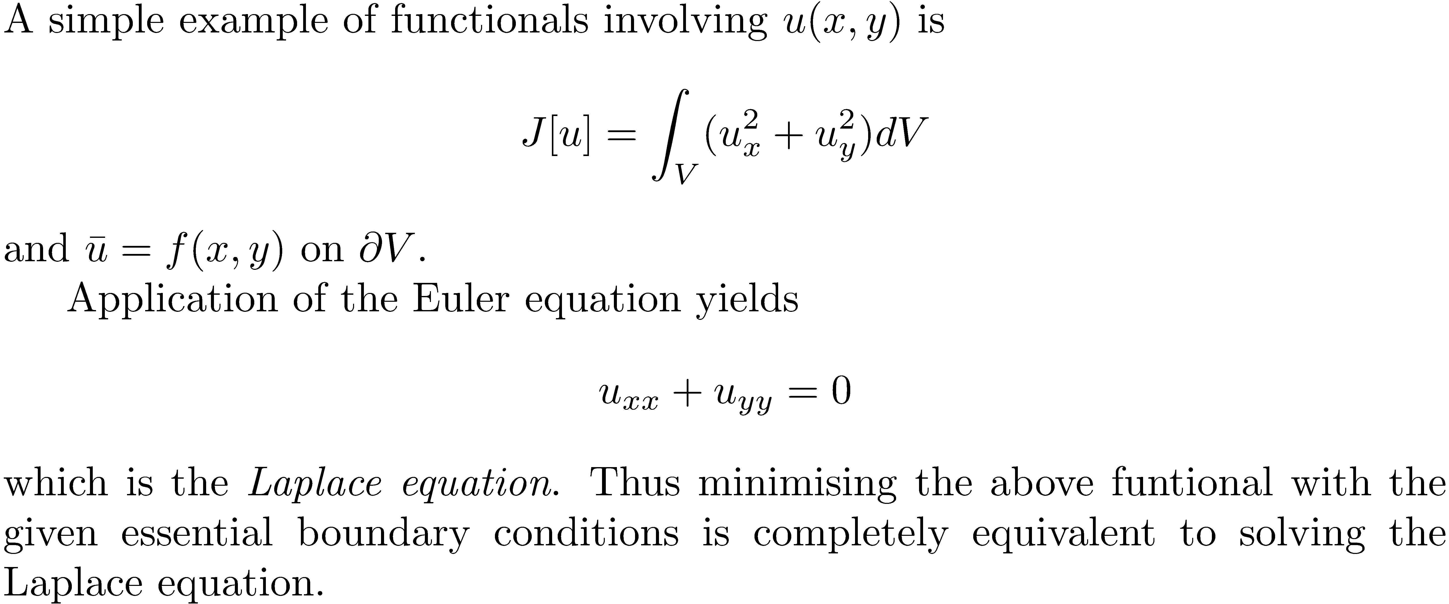

Slide 23
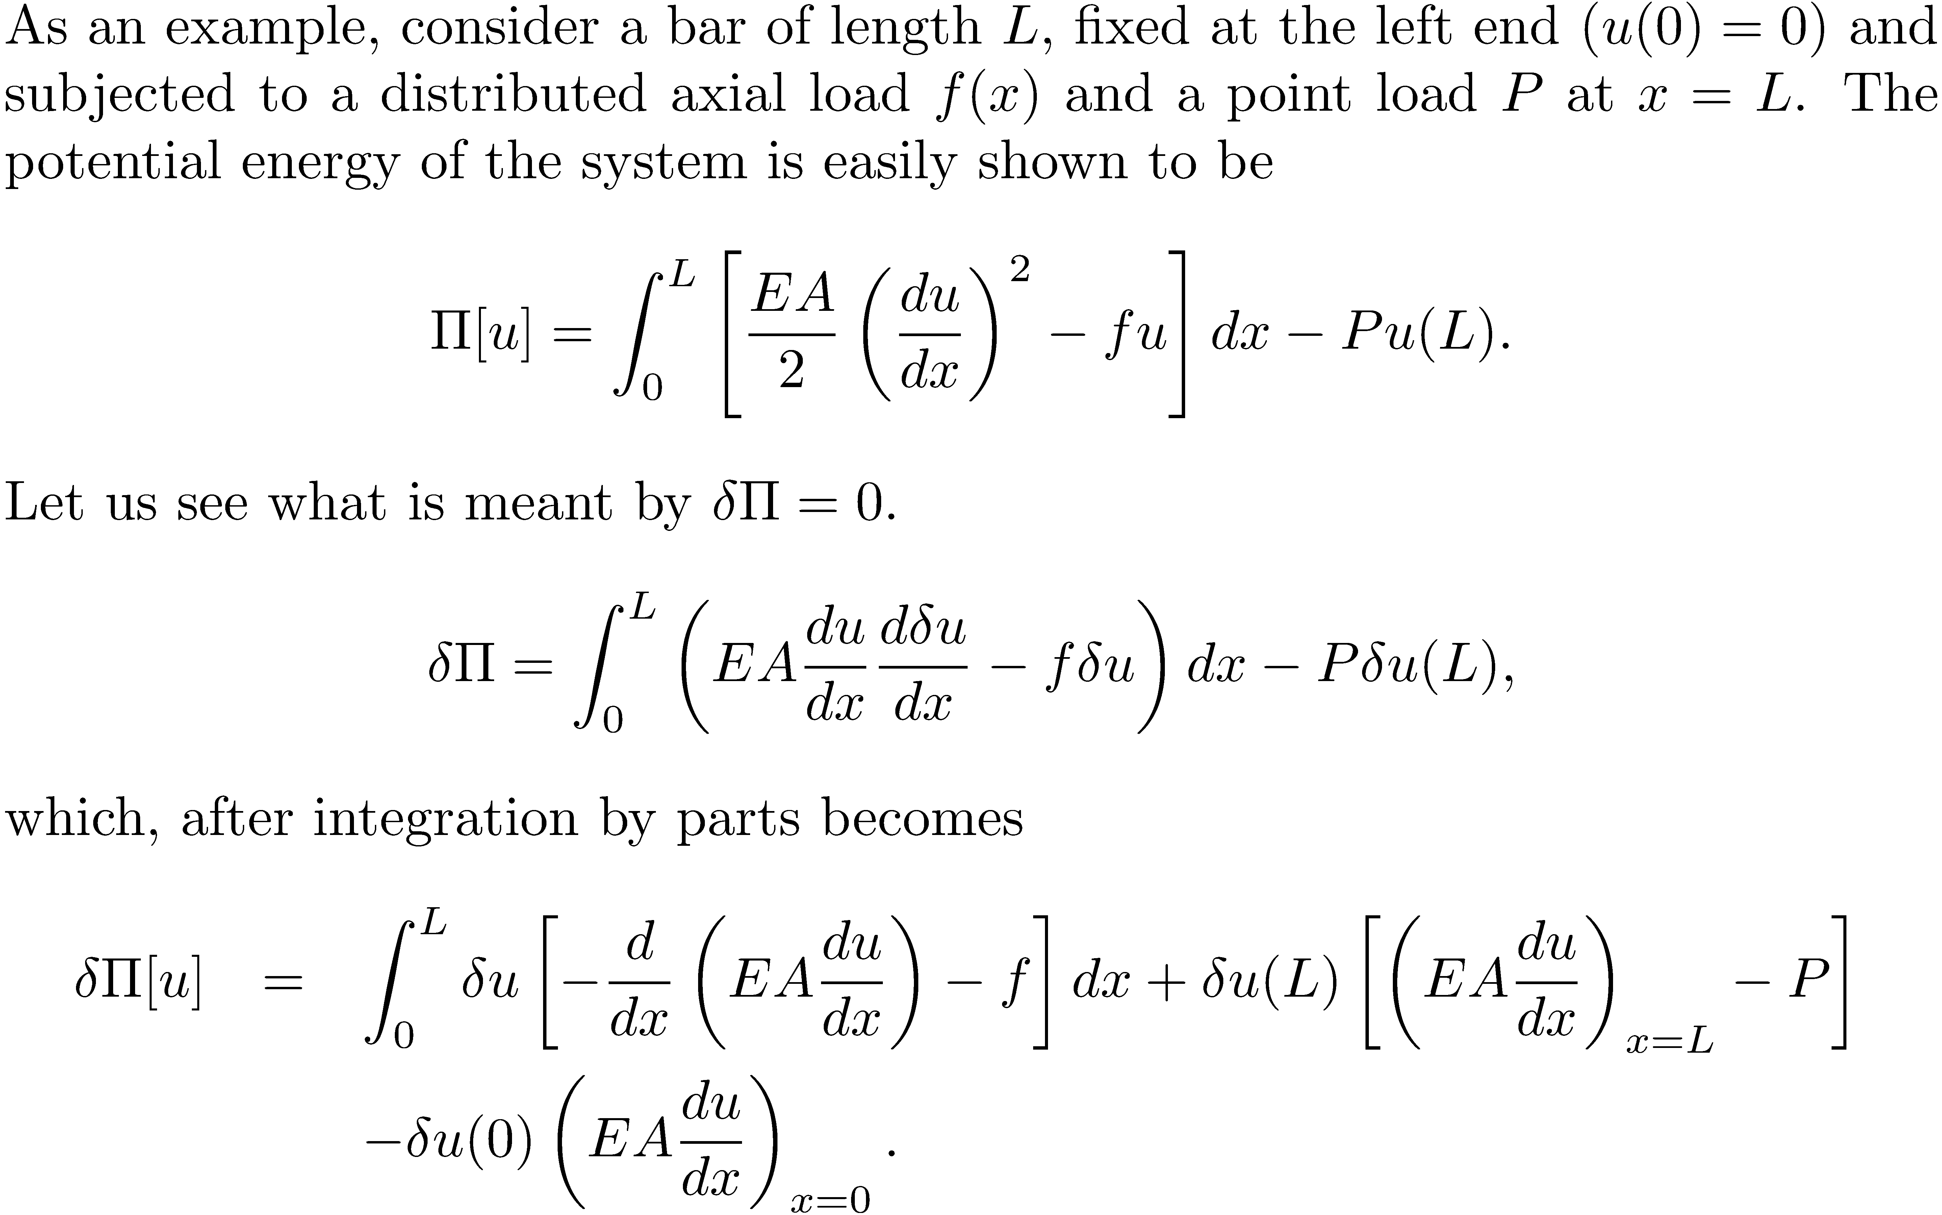

Slide 24
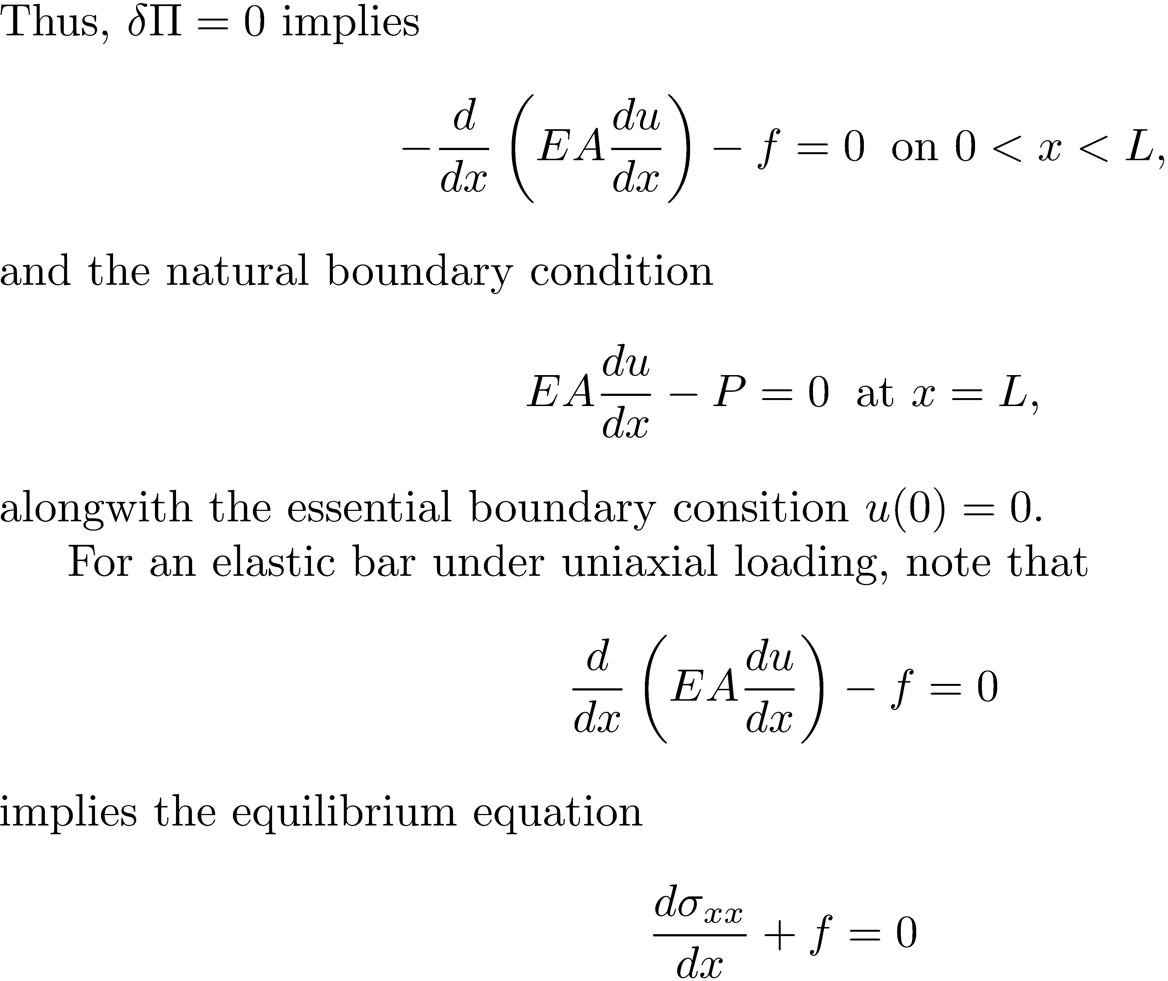

Slide 25
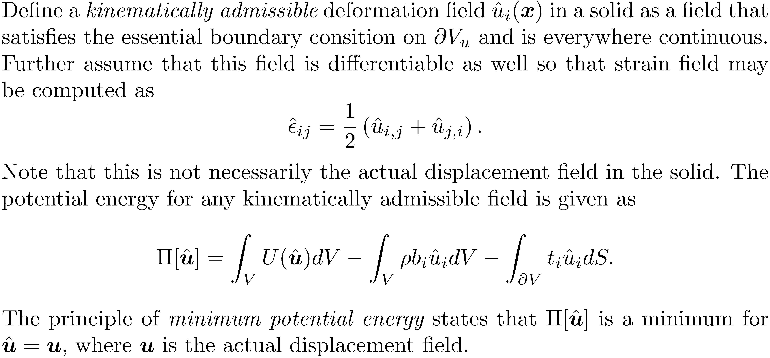
Principle of minimum potential energy

Slide 26
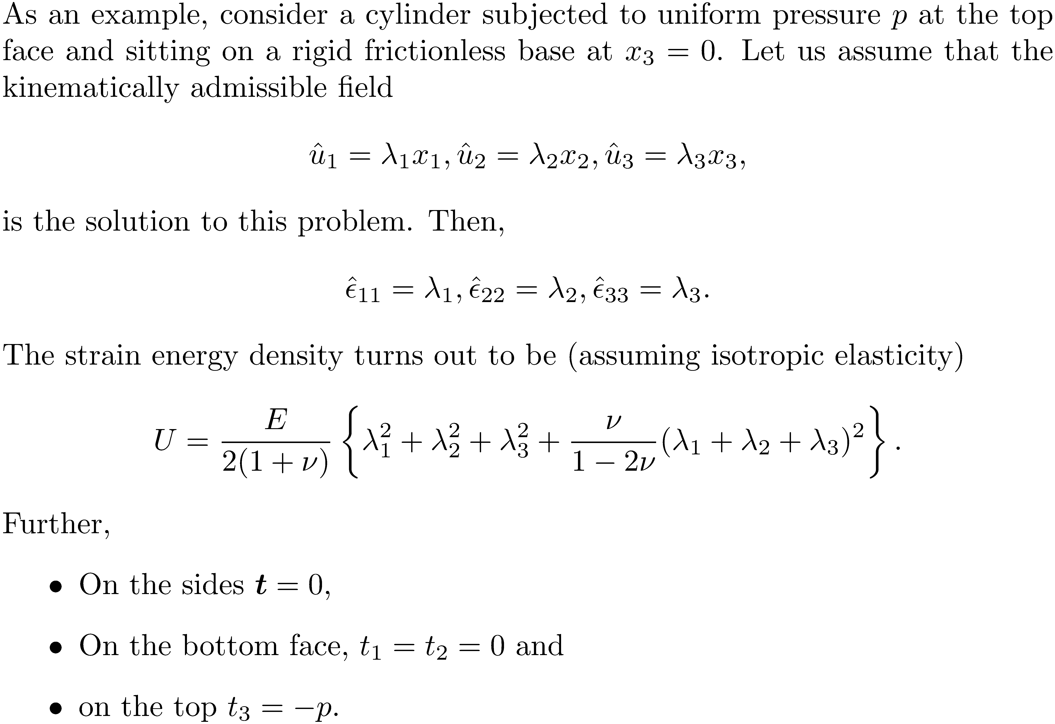

Slide 28
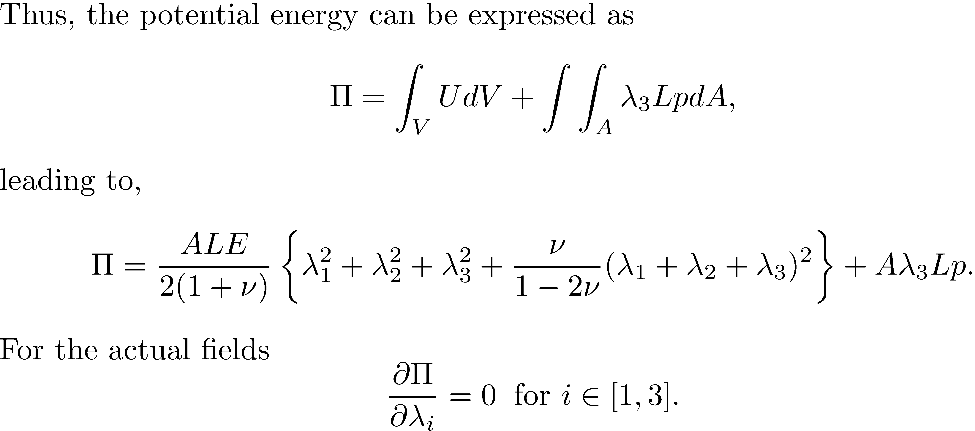

Slide 29
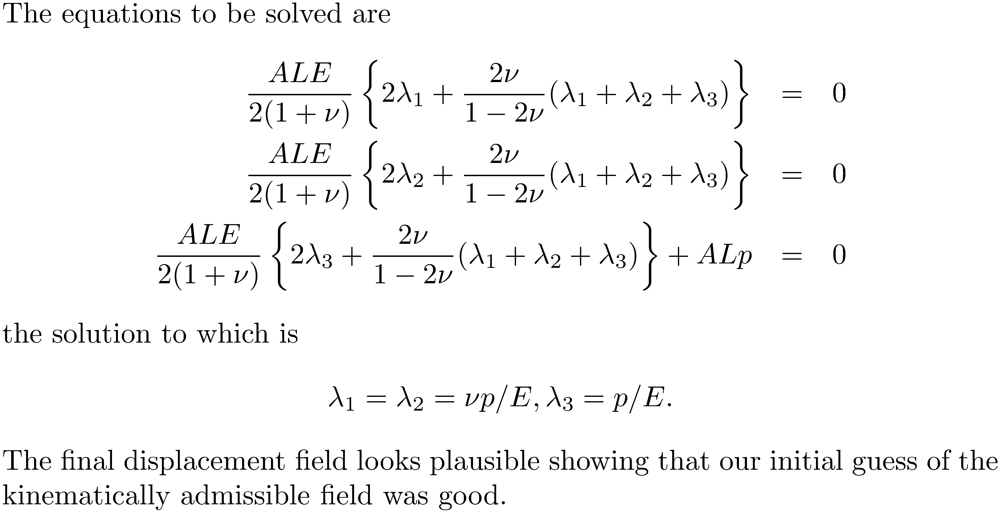

Slide 30
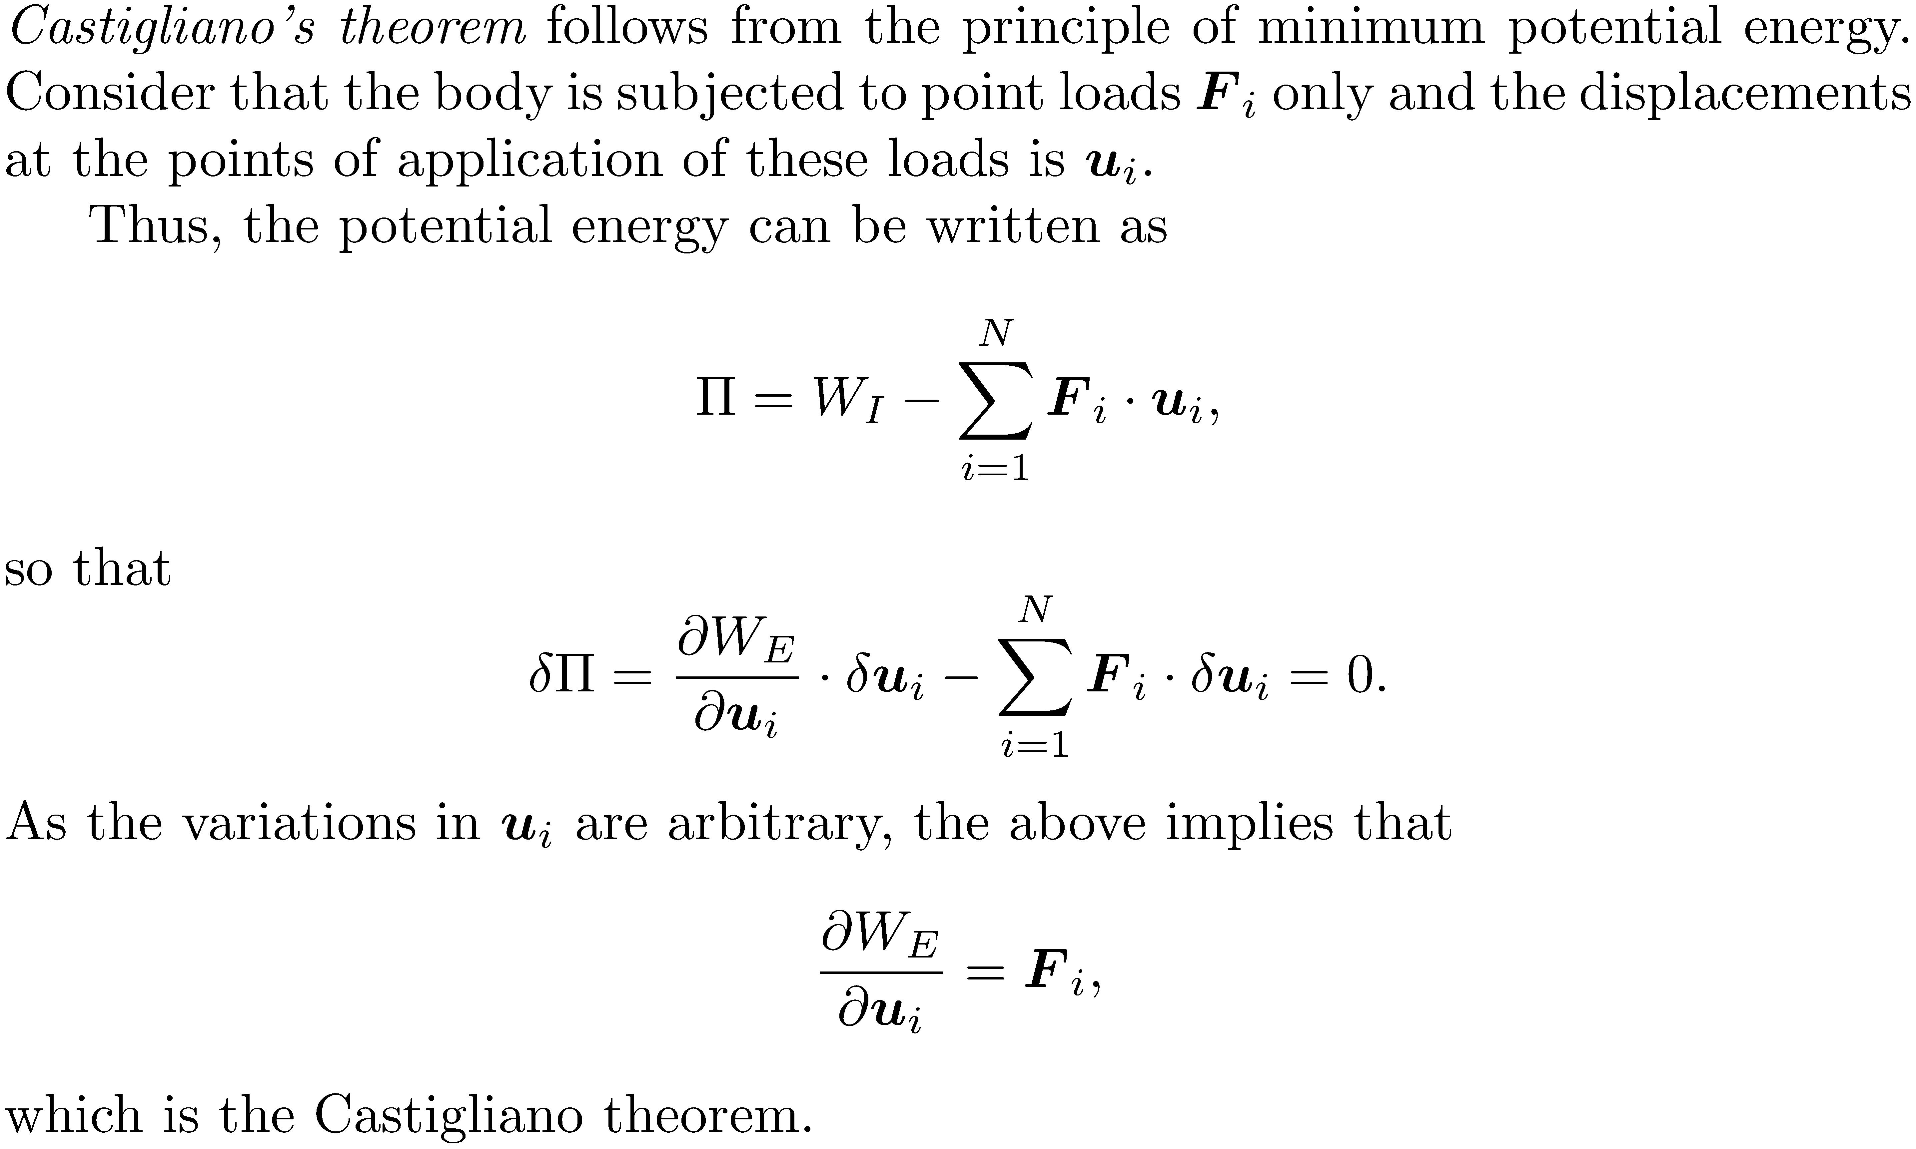

Slide 31
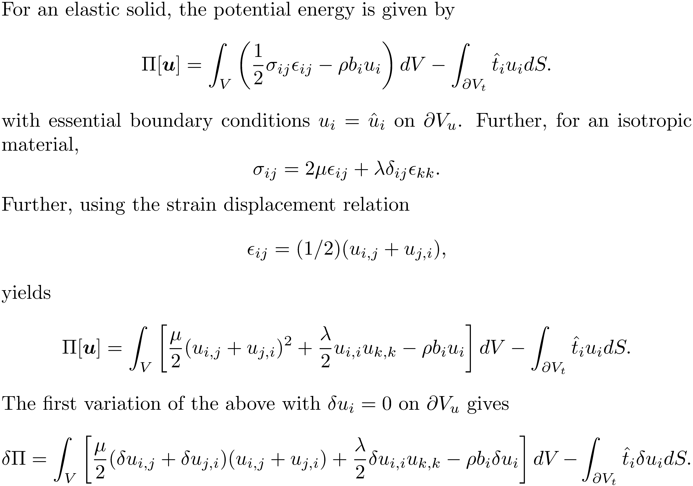

Slide 32
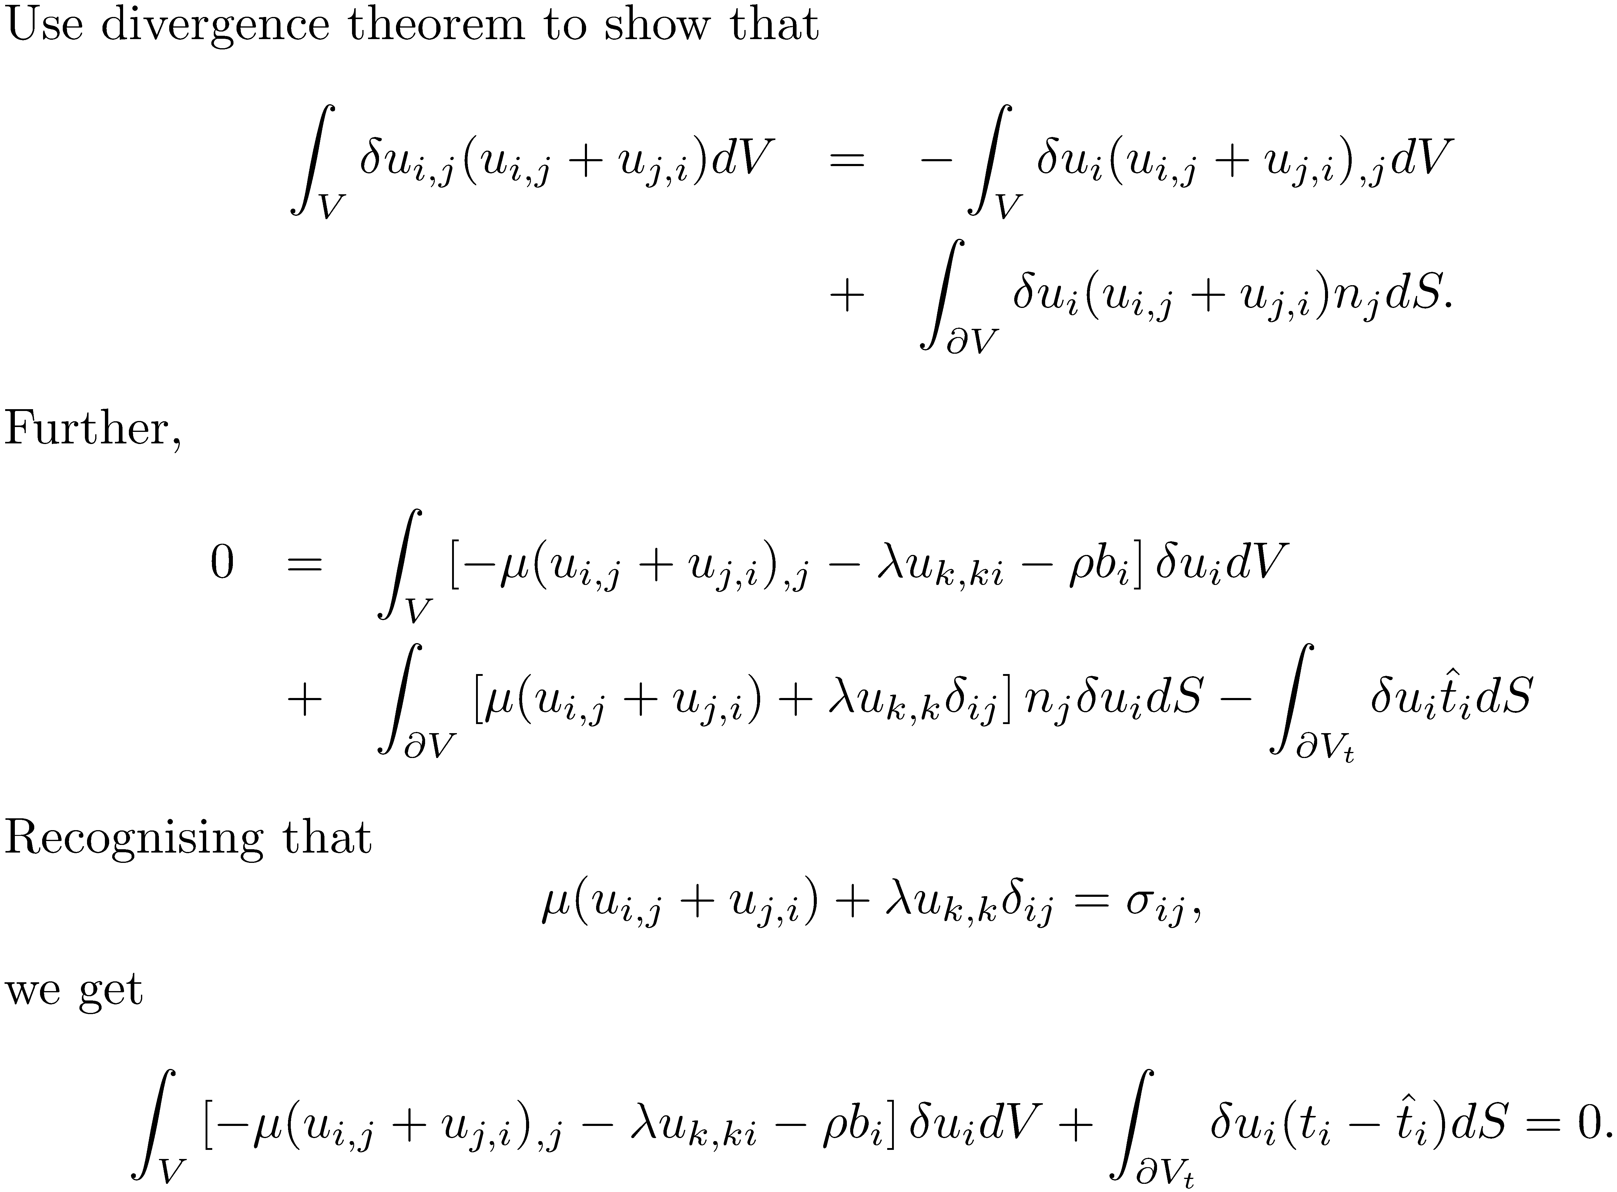

Slide 33
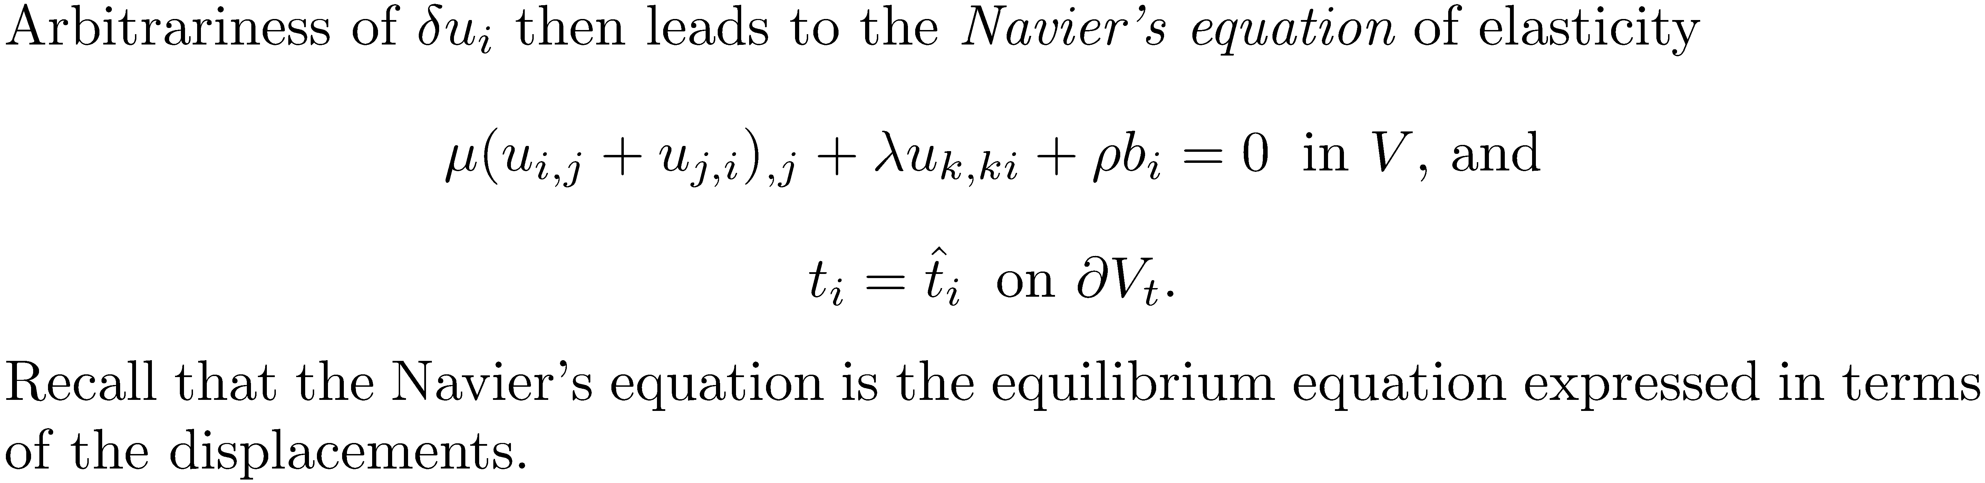

Slide 34
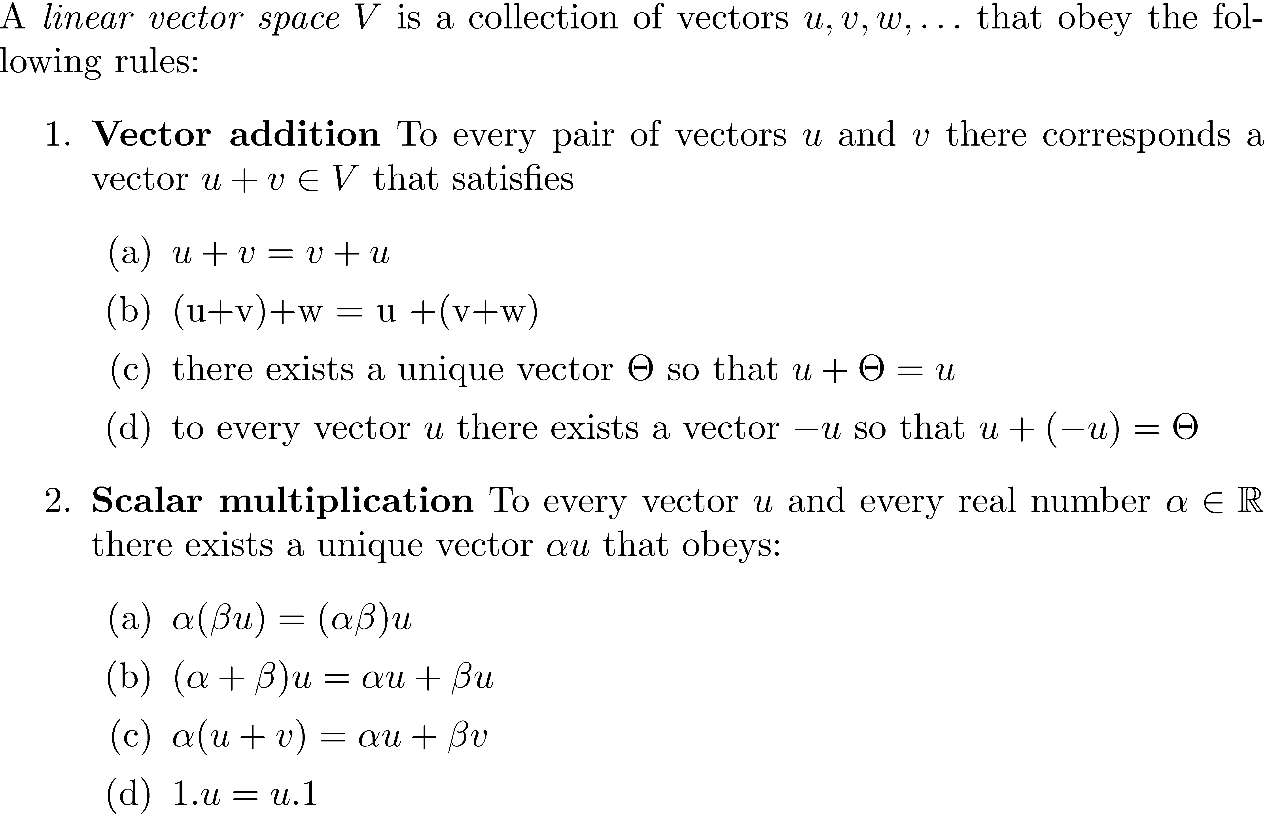
A bit about vector spaces, norms and inner products

Slide 35
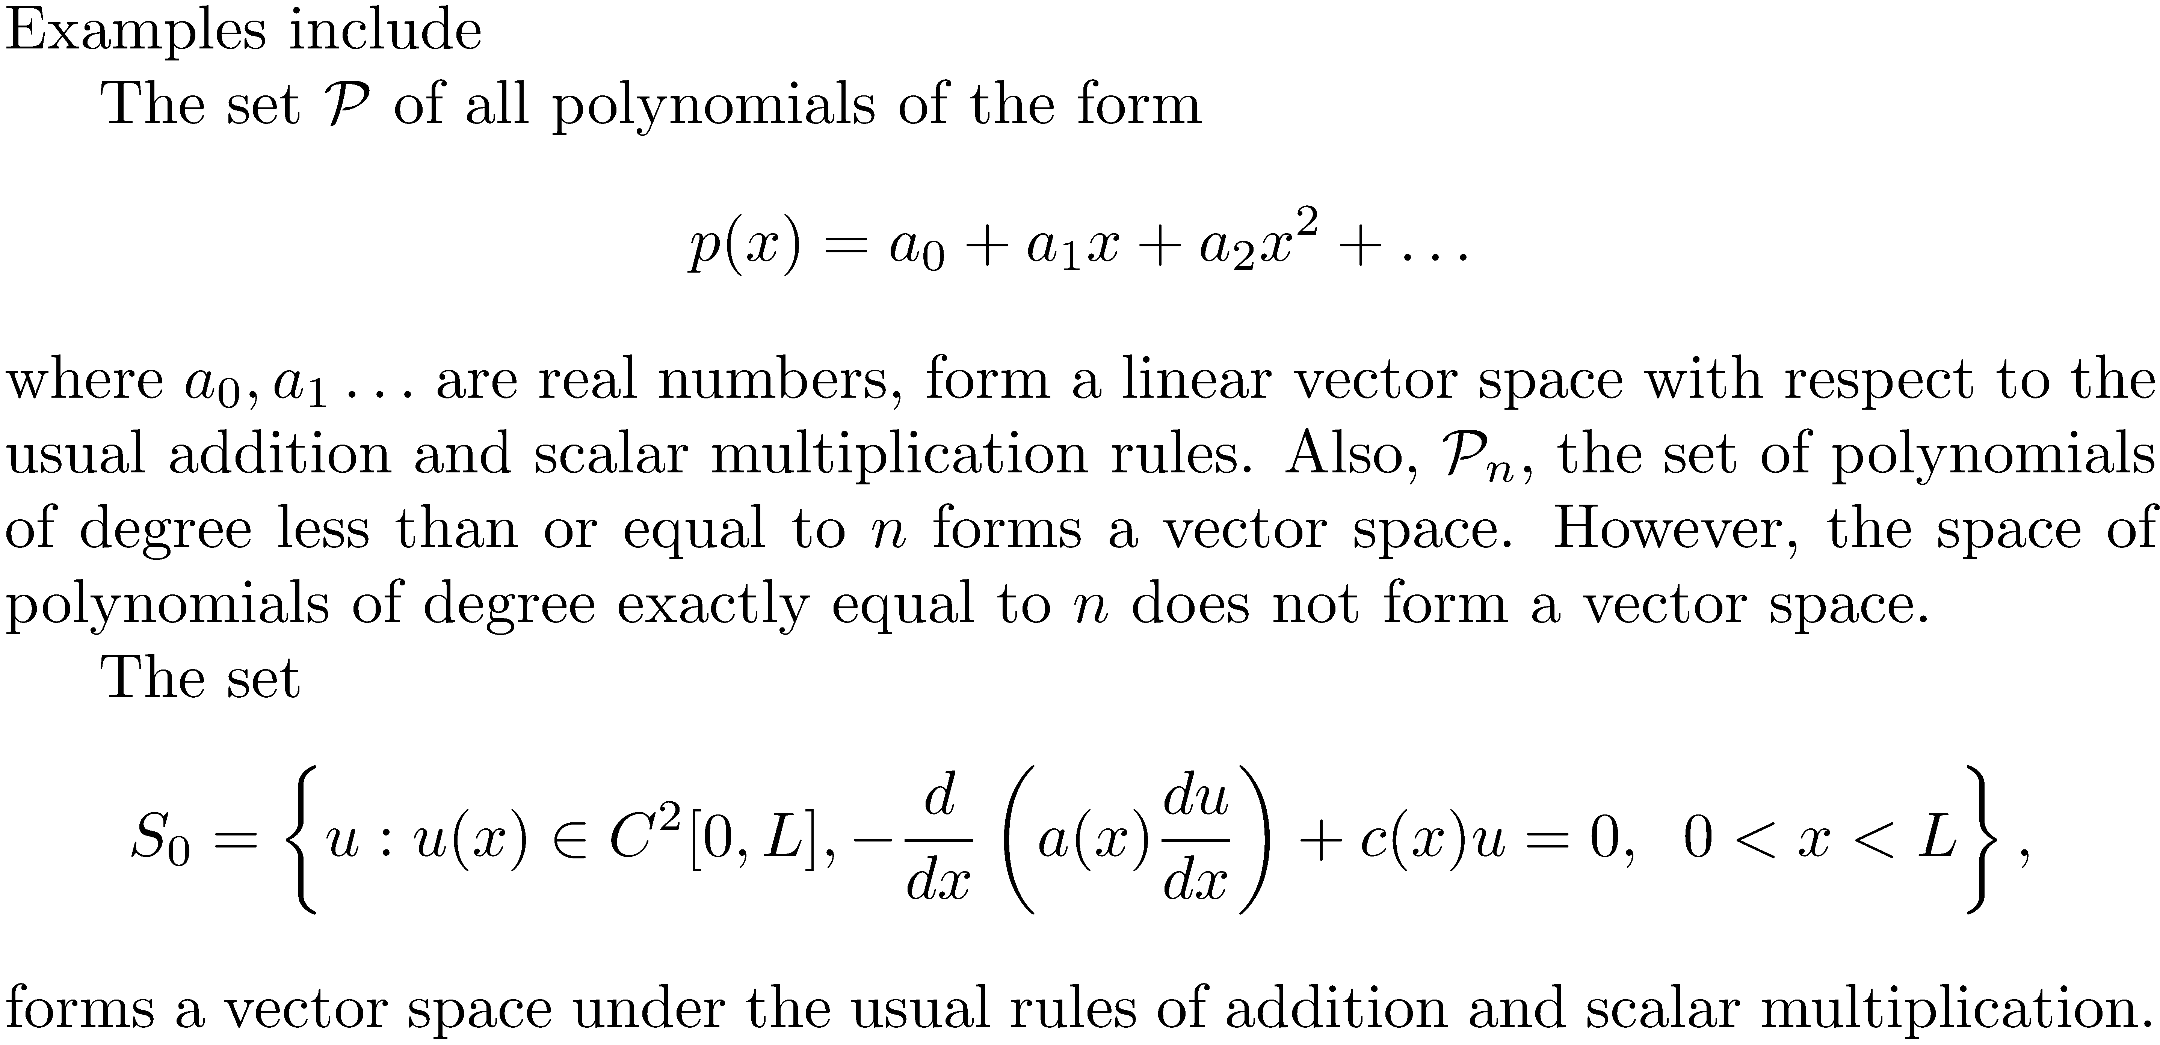

Slide 36
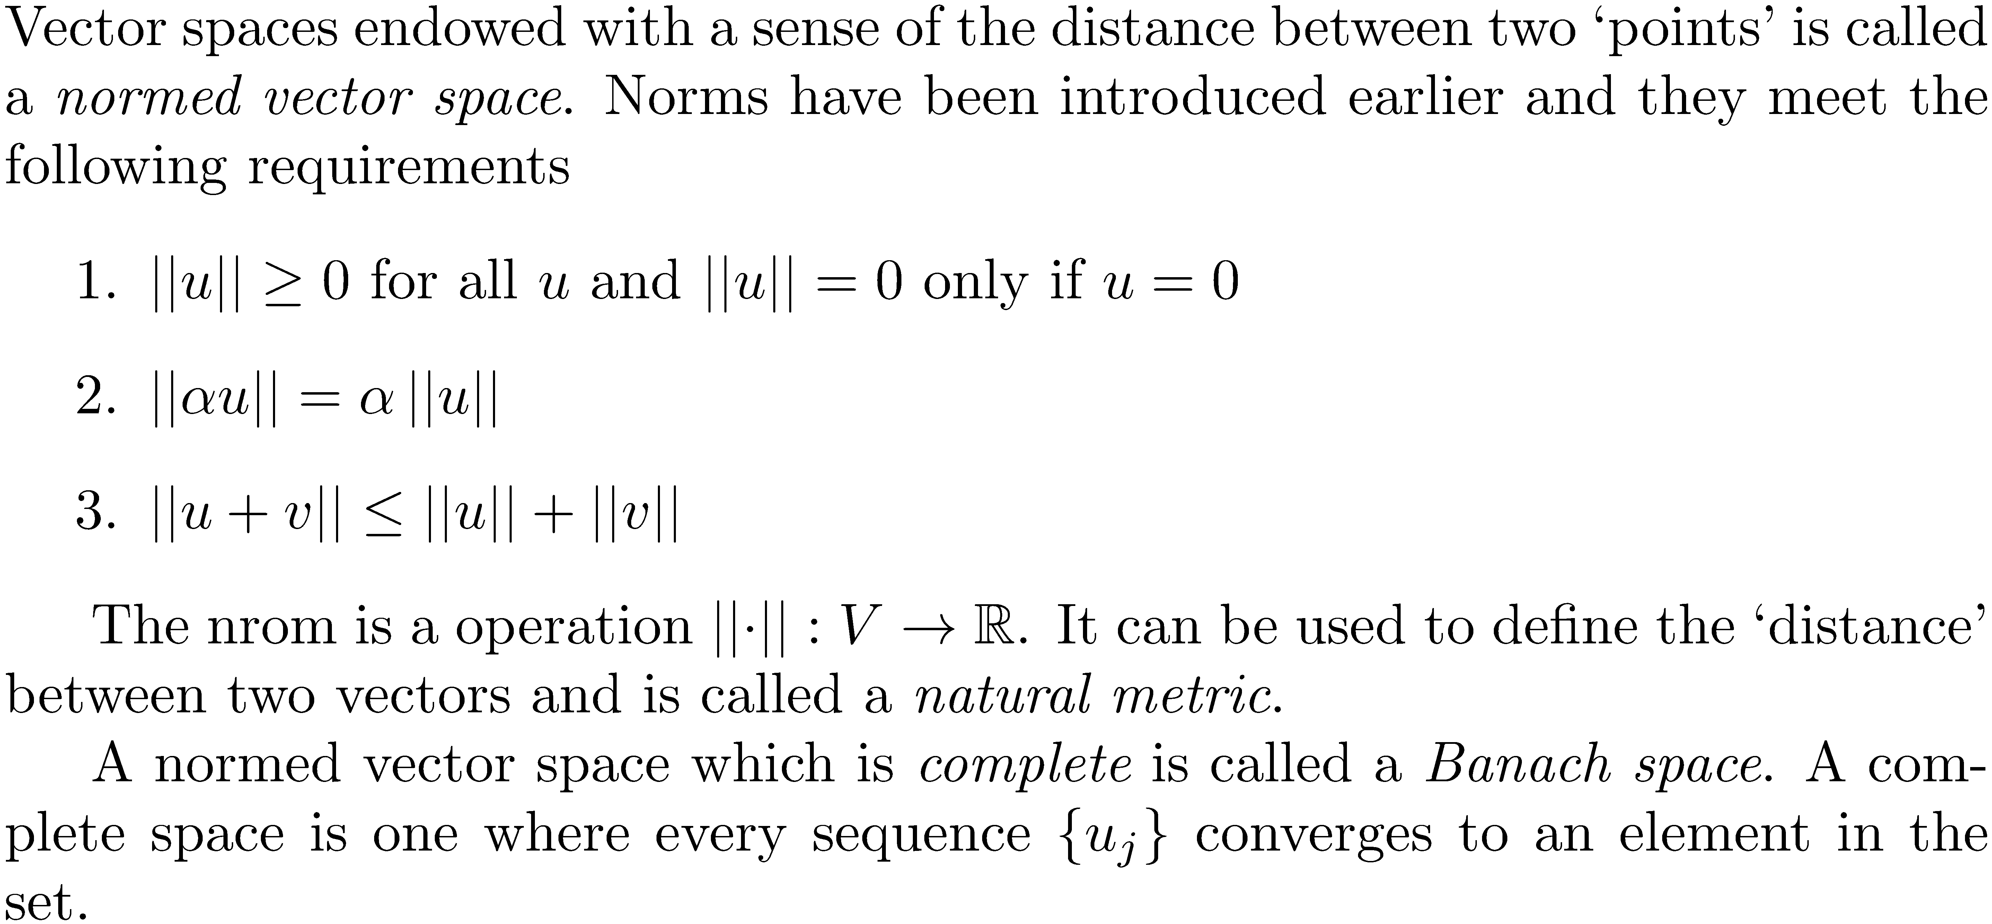

Slide 37
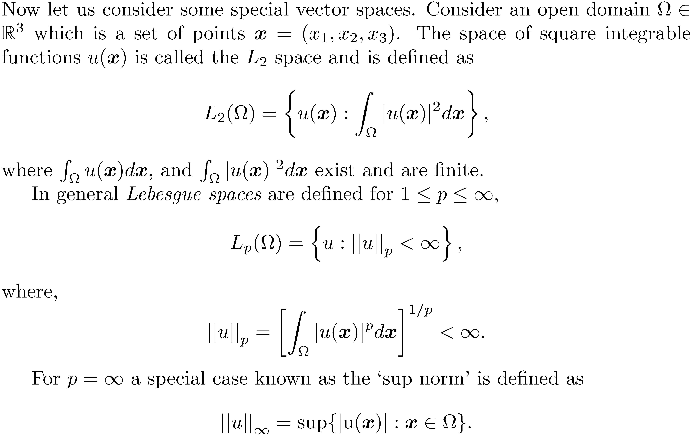

Slide 38
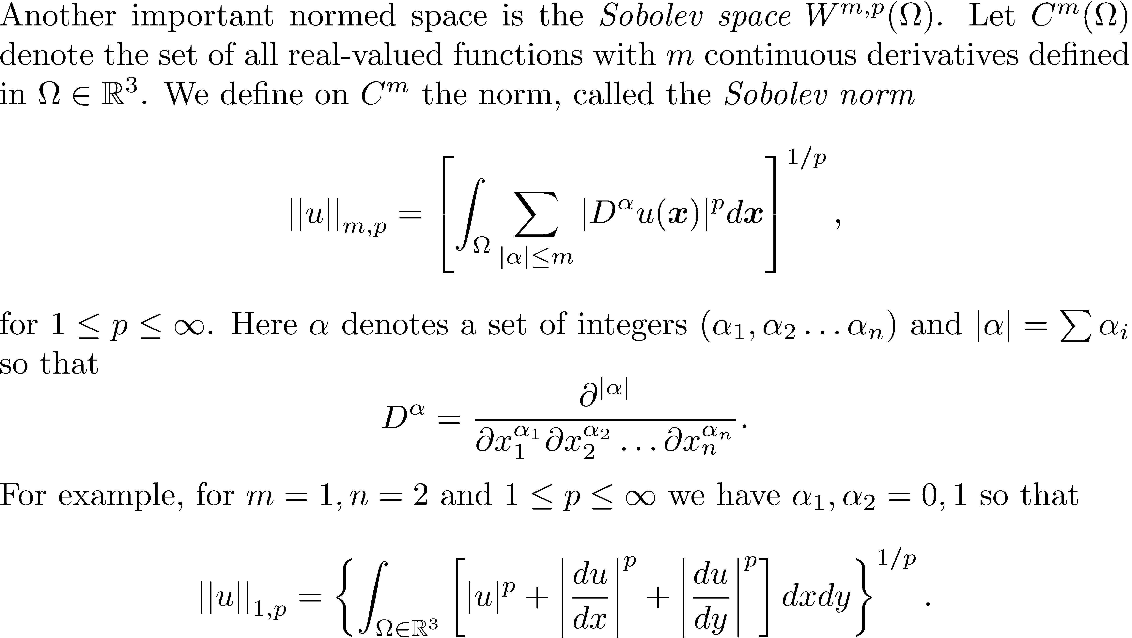

Slide 39
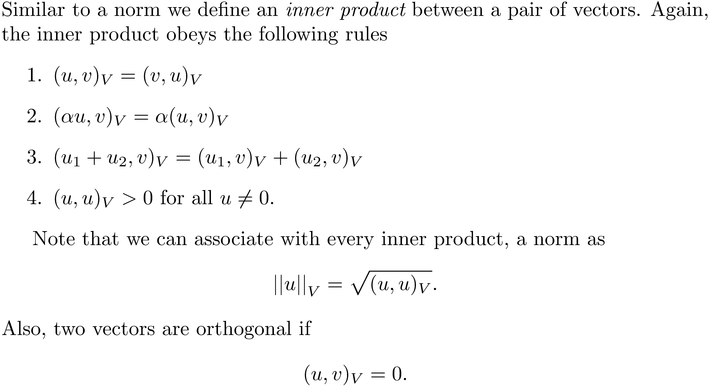

Slide 40
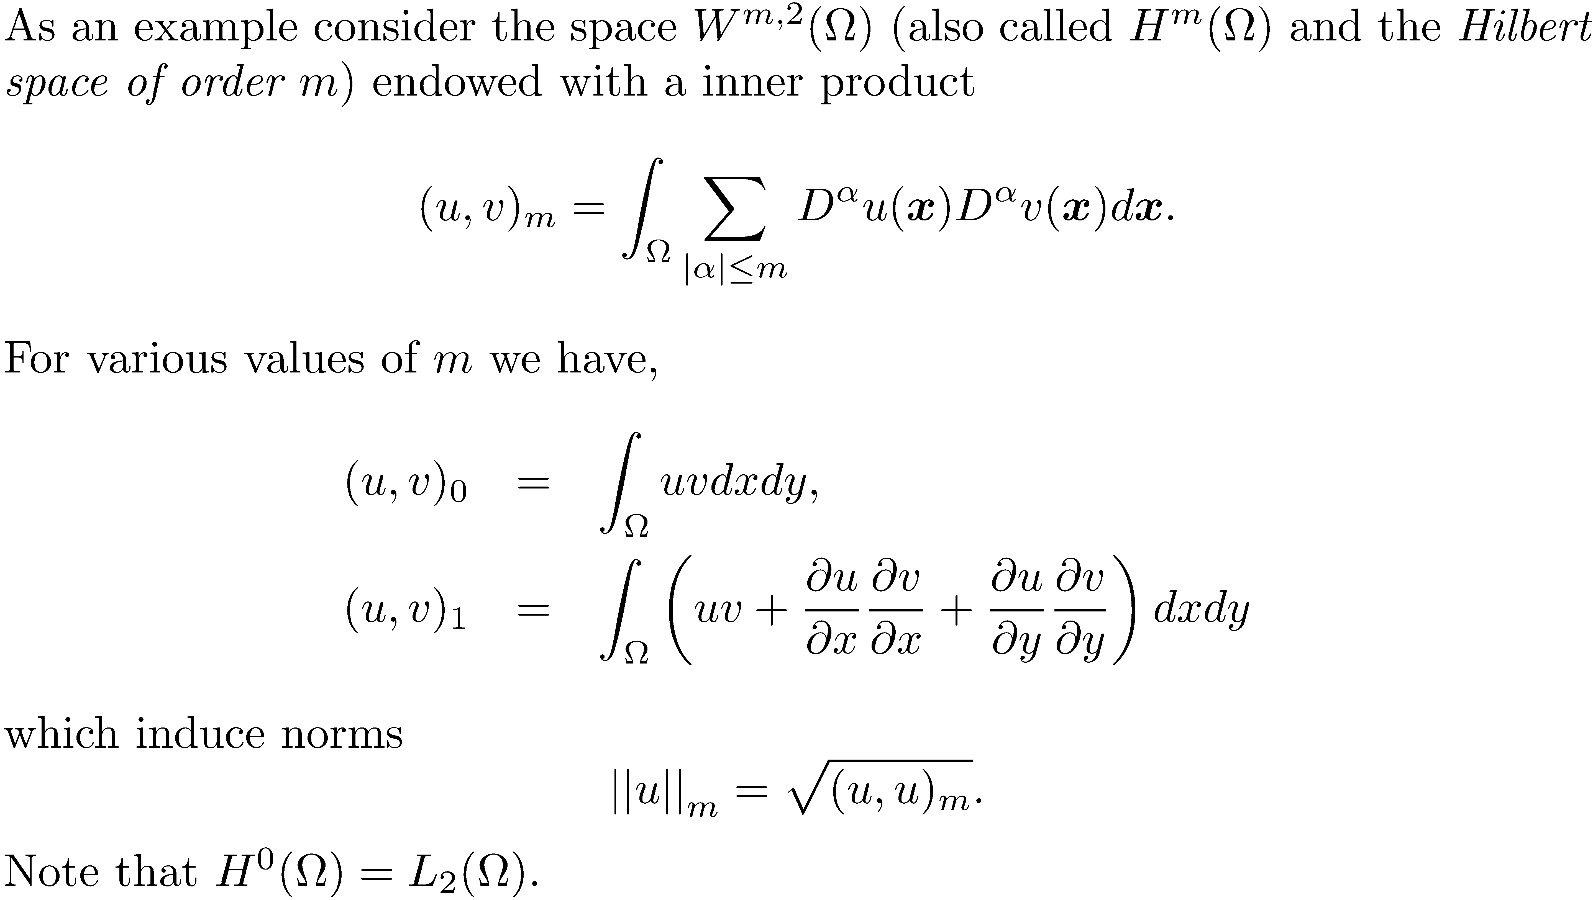

Slide 41
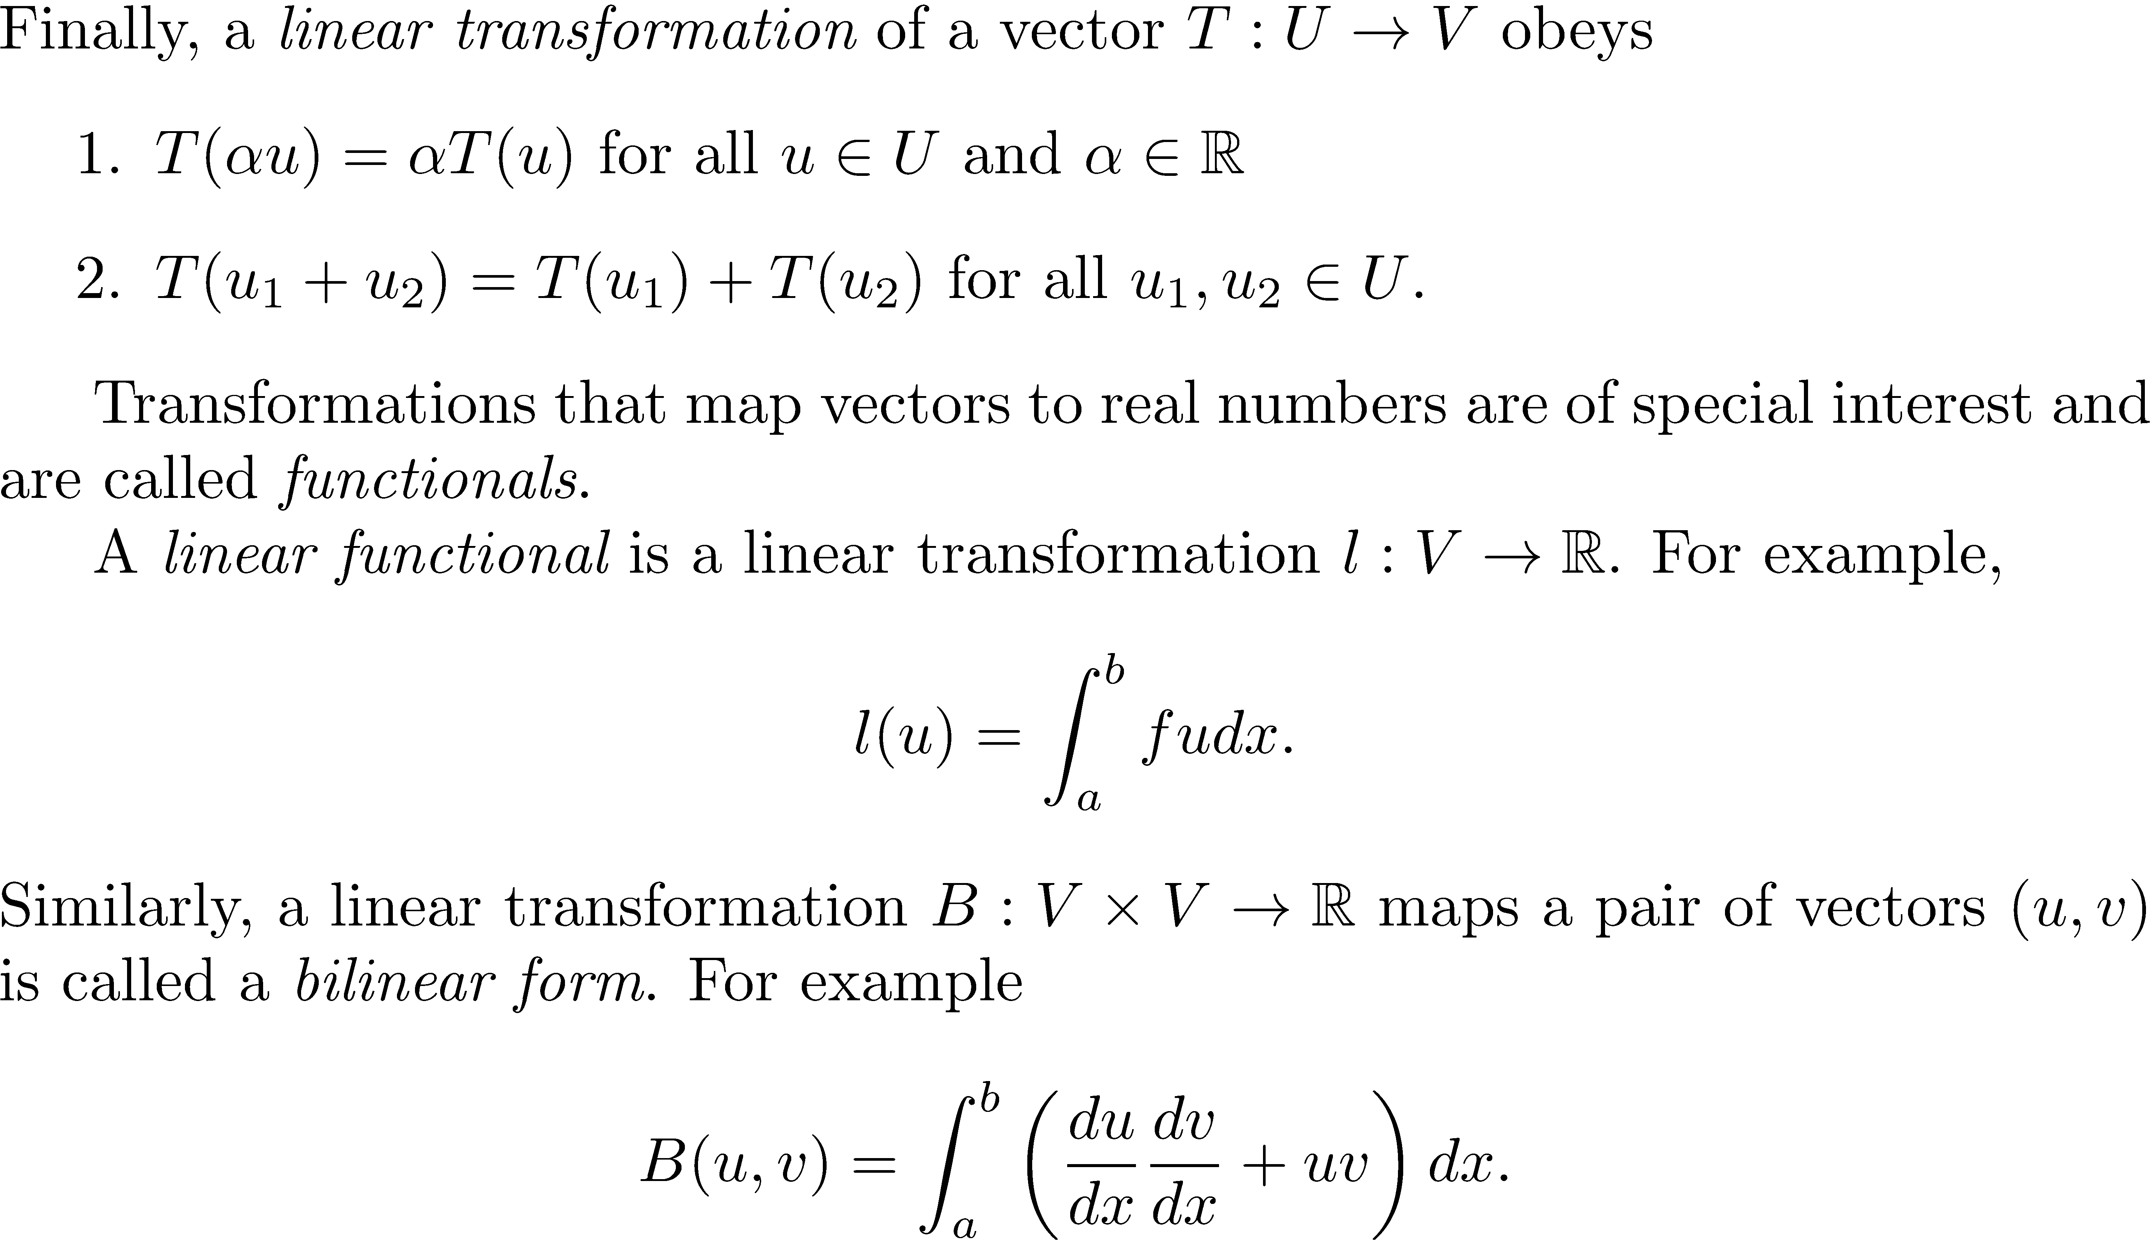

Slide 42

An important result on differential equations and functionals

Slide 43


Slide 44


Slide 45


Slide 46


Slide 47


Slide 48


Slide 49


Slide 50


Slide 51


Slide 52


Slide 53


Slide 54


Slide 55


Slide 56

Rayleigh Ritz method for solving problems cast in the weak form

Slide 57


Slide 58


Slide 59


Slide 60


Slide 61


Slide 63

Another method for creating weak forms from strong ones: Weighted residual technique

Slide 64


Slide 65


Slide 66
Weighted Residual techniques: an example

Slide 68

FEM approximations: the basic idea

Slide 69
















Slide 70


Simple cases: bars and beams
x
L

Slide 71


Slide 72


Slide 73






x
L

Slide 74



x
L
Shape function matrix
Strain displacement matrix

Slide 75


Slide 76


Slide 77


Slide 78


Slide 79


Slide 80


Slide 81


Slide 82

2-d elasticity problems
S
Linear triangle, 3 nodes/element, 2 dofs/node
V

Slide 83
Shape functions

Slide 84

Strain-displacement matrix

Slide 85
Strains are constant within an element: Constant strain triangle (CST)

Slide 86

Quadratic traingle (Linear strain triangle)

Slide 87



A small example problem with CSTs
4
3
3
1 unit
4
5
2
1 unit
1
1
2

Slide 88

P (x,y)
1
A₂
A₃
A₁
y
3
2
x

Slide 89


Slide 90


